Slide 1
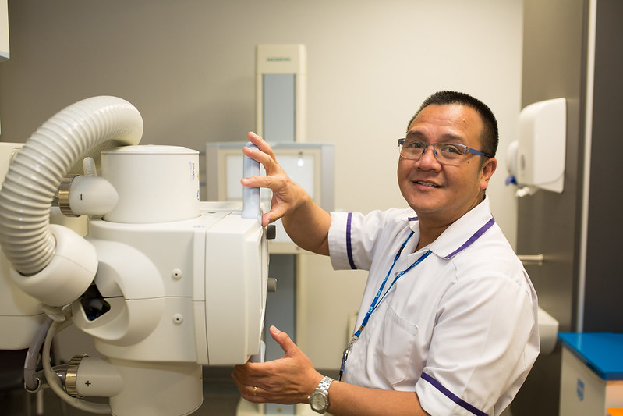


Are you one of the five million people waiting for hospital care?
#BecauseWeAllCare

Slide 2


Whether your experience of care is good or bad – we want to hear it.
#BecauseWeAllCare

Slide 3


We’re here to listen to your experiences and be your champion for positive change.
#BecauseWeAllCare

Slide 4
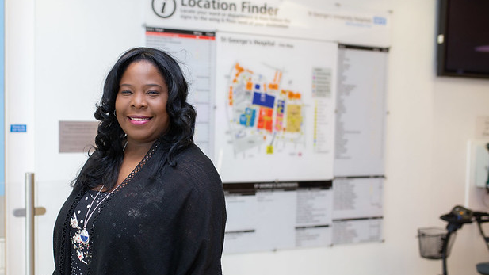

If nobody hears what you’ve been through, nothing can change.
#BecauseWeAllCare

Slide 5
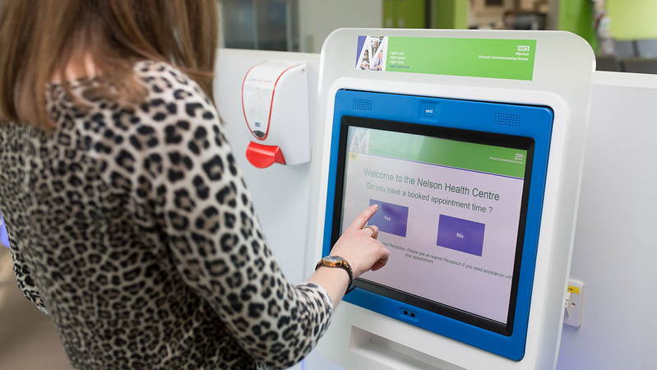
Help improve NHS support for people like you.
#BecauseWeAllCare

Slide 6
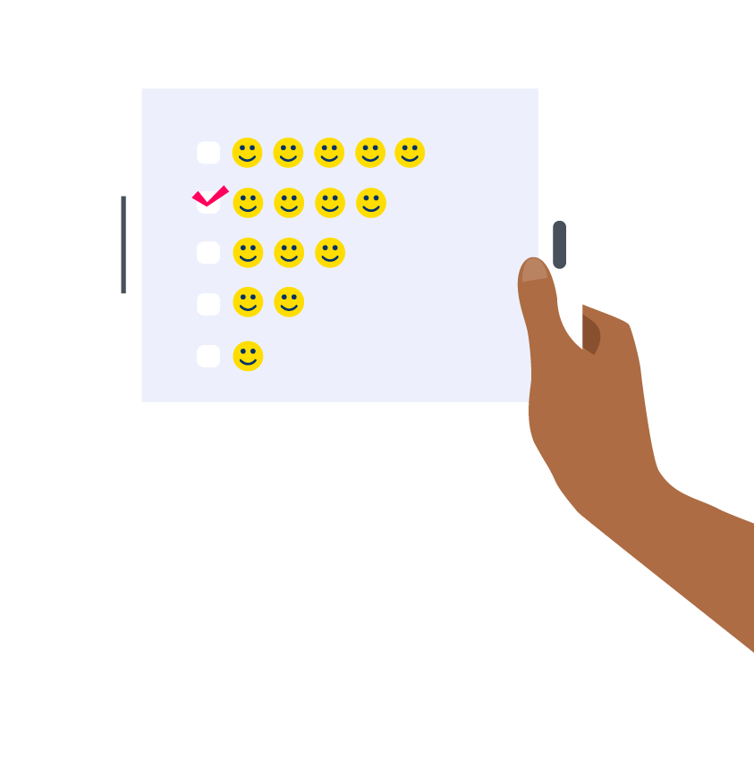

How you rate the support you’ve received while waiting for NHS hospital treatment?
#BecauseWeAllCare

Slide 7
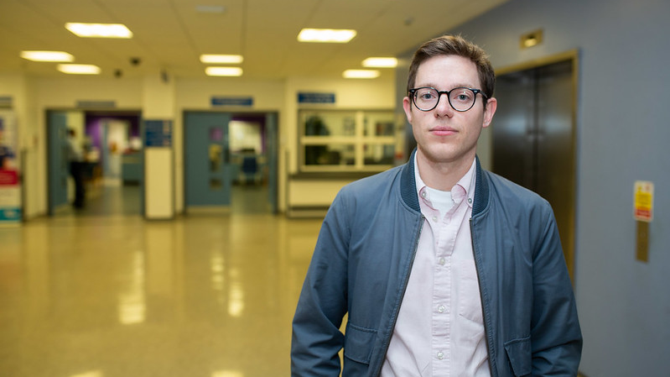
Tell us how the pandemic affected your care?
#BecauseWeAllCare

