Slide 1
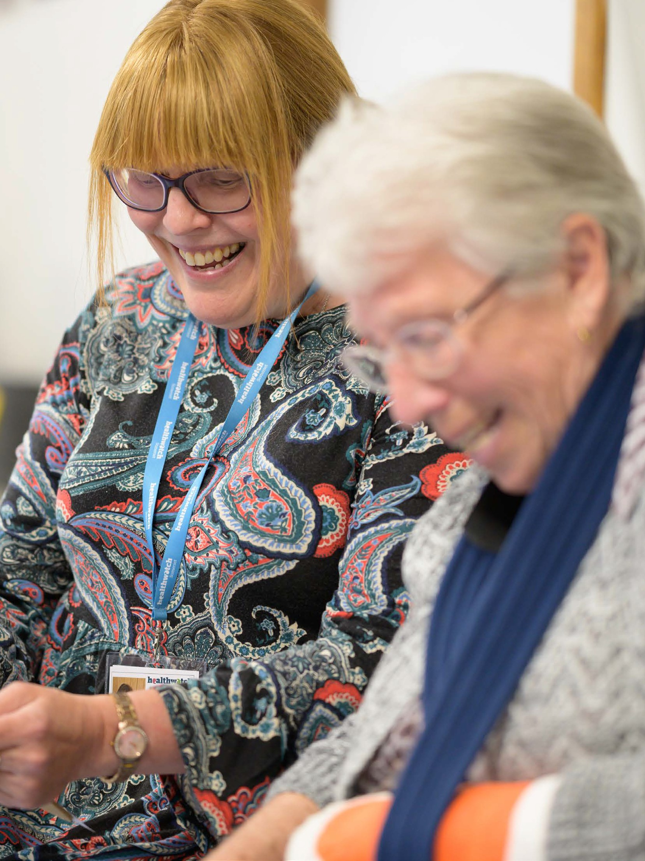
Don’t forget to insert your own local Healthwatch logo. On this cover the logo is in the top right corner.
To change the logo right click on it > change picture > from file > choose logo
Make sure its placed not too close to the top or the right hand edges and should be approx. 70mm in length or take up a third of the page. Use the main Healthwatch logo as a guide.
You can download different versions of your logo by logging into the Communications Centre on the Network Site. On the right hand side, ‘search assets’ and type the name of your local Healthwatch
Remember, this is a template. You can change the title if you wish.
Covers
We’ve included two cover options for you to choose from. Add the name of your Healthwatch and your logo. Then delete the covers you are not using. You can also personalise the covers by using your own photography.
To change the photo:
Double-click on the photo.
From the main menu, select: Format > Change Picture.
Ensure new picture sits fully behind the green curve, resize if not.
Delete this box.
Together
It is not necessary to have a photo caption on the front cover of your report. Use a blank inside page if a caption is necessary.
we’re making health
and social care better
Annual Report 2022–23

Slide 2
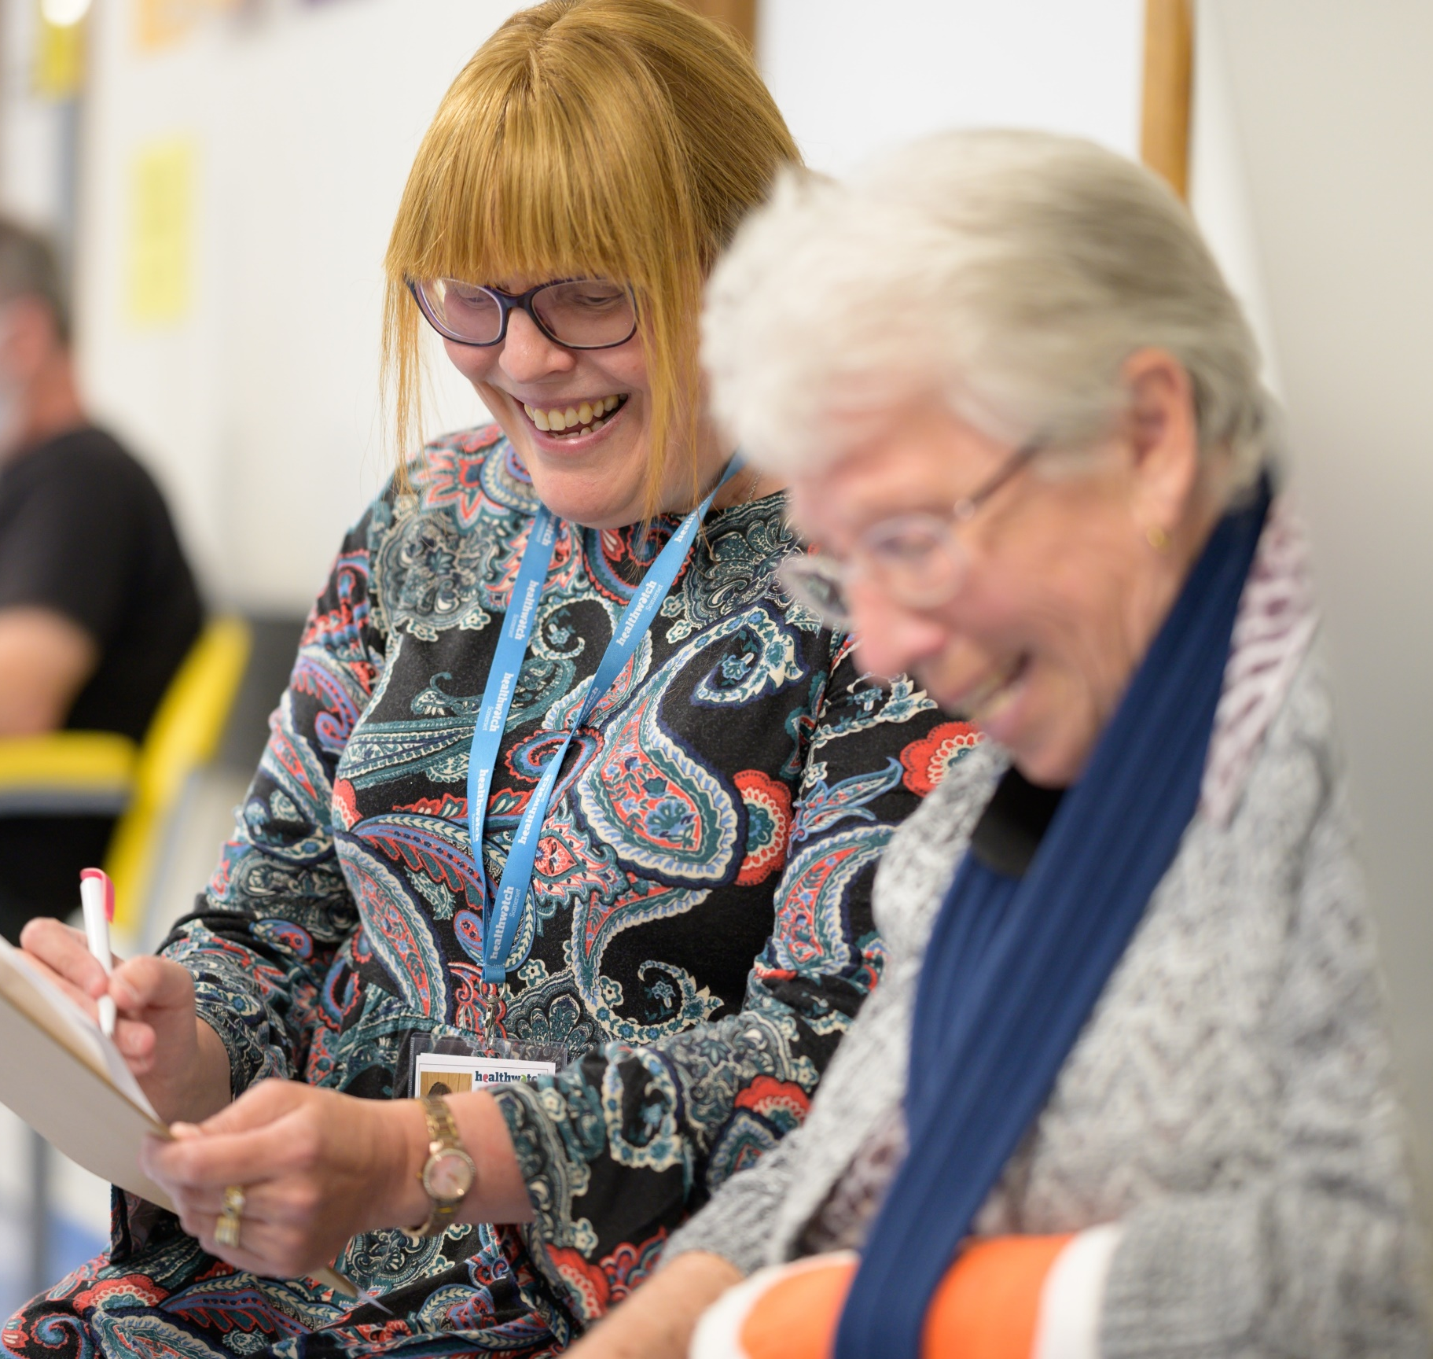
Don’t forget to insert your own local Healthwatch logo. On this cover the logo is in the top right corner.
To change the logo right click on it > change picture > from file > choose logo
Make sure its placed not too close to the top or the right hand edges and should be approx. 70mm in length or take up a third of the page. Use the main Healthwatch logo as a guide.
You can download different versions of your logo by logging into the Communications Centre on the Network Site. On the right hand side, ‘search assets’ and type the name of your local Healthwatch
Together
we’re making health
and social care better
Remember, this is a template. You can change the title if you wish.
Annual Report 2022–23
Covers
We’ve included two cover options for you to choose from. Add the name of your Healthwatch and your logo. Then delete the covers you are not using. You can also personalise the covers by using your own photography.
To change the photo:
Double-click on the photo.
From the main menu, select: Format > Change Picture.
Ensure new picture sits fully behind the green curve, resize if not.
Delete this box.
It is not necessary to have a photo caption on the front cover of your report. Use a blank inside page if a caption is necessary.

Slide 3
Contents
To insert your local Healthwatch name in the footer
Click Insert to get the drop down menu at the top of your screen.
Click on to Header and Footer.
In the dialogue box add your local Healthwatch name in the box and select Apply to all.
Contents
You’ll need to update the contents page manually once your document is complete.
Message from our Chair
About us
Highlights from our year
Listening to your experiences
Advice and information
Volunteers
Finances and future priorities
Statutory statements
4
5
6
8
12
14
16
17
"In the last ten years, the health and social care landscape has changed dramatically, but the dedication of local Healthwatch hasn't. Your local Healthwatch has worked tirelessly to make sure the views of local people are heard, and NHS and social care leaders use your feedback to make care better."
Louise Ansari, Healthwatch National Director

Slide 4
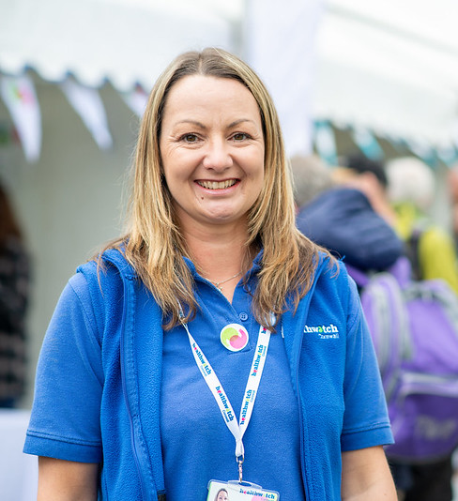
Message from our Chair
Talk about how you have tried to reach communities that aren’t often heard from.
The term seldom heard groups often refers to under-represented people who use, or might potentially use, services and who are less likely to be heard by these service professionals and decision makers.
Examples of seldom heard groups might include
Ethnic minority groups
Carers
People with disabilities
Lesbian, Gay, Bisexual, Transgender or Queer people
Refugees / asylum seekers
People who are homeless
Younger people
People with language barriers
Reminder – We recommend you no longer use terms such as BAME to describe people. See here for more information https://healthwatch163.workplace.com/groups/280616882574510/permalink/765439327425594/
Introduction: This needs to be a short overview about the last year and how your organisation has adapted and thrived.
Here’s what you could include:
How you have listened to and included everyone in the local community
Have you analysed people’s experiences to spot trends and create change?
Have you acted on feedback to drive change and improve services for people?
How has your work made a difference to people’s lives?
How have you made sure that your local community is heard by your NHS at Integrated Care Systems level?
How you have worked together with other Healthwatch to be effective and influence decisions taken by Integrated Care Boards and Partnerships?
[Try not to repeat anything that is detailed further on in the report.]
Name of Chair Healthwatch [x] Chair
Section word count – 150 words
You can import a signature if you would like to add a touch of personalisation
To add a signature make sure you’ve saved the signature as a png file so its on a transparent background.
Insert the png of the signature as you would an image.
Image
This image is for positional
purposes only, ensure you replace with a picture of your Chair
To crop your image, click on your image, and click the tab Format. Here you can crop your image if necessary.
To scale your image up or down, hold down the shift key and drag a corner to the size you want.
Sitting in the dentist’s office, listening to the cost of treatments brought me to tears. Whenever I eat and feel a twinge my heart drops. I panic that something terrible is happening. MPs have money to get care if they need, most people don’t. There’s no version of private dentistry that’s affordable.”
Update this quote for one from your own Chair.
Quote word count – 60 words

Slide 5
About us
Make sure to change the pink text in brackets in to black after inserting your information throughout the document
Healthwatch [insert town] is your local health and social care champion.
We make sure NHS leaders and decision makers hear your voice and use your feedback to improve care. We can also help you to find reliable and trustworthy information and advice.
Our vision A world where we can all get the health and care we need.
Our mission To make sure people’s experiences help make health and care better.
Our values are:
Listening to people and making sure their voices are heard.
Including everyone in the conversation – especially those who don’t always have their voice heard.
Analysing different people’s experiences to learn how to improve care.
Acting on feedback and driving change.
Partnering with care providers, Government, and the voluntary sector – serving as the public’s independent advocate.

Slide 6
Year in review
Guidance: Reaching out
Here you can include the number of people who shared their experience with you last year, either online, on the phone or in person.
The number of people you provided advice to can be calculated by looking at the number of people who viewed your advice online, and the number of people you provided advice to over the phone and via email.
Reaching out
[X] people
shared their experiences of health and social care services with us, helping to raise awareness of issues and improve care.
[X] people
came to us for clear advice and information about topics such as mental health and the cost of living crisis.
Making a difference to care
Guidance: Making a difference to care
Include the number of reports you have published in the last year.
Name your most popular report, either the report that got the most views on your website or the report that led to the biggest improvement.
We published
[X] reports
reports about the improvements people would like to see to health and social care services.
Our most popular report was
[insert report name]
which highlighted the struggles people face on X.
Guidance: Health and care that works for you
We recommend you display the time your volunteers contribute in days (number of hours divided by 8) because this gives an amount of time your reader can easily visualise. However, if that number sounds quite low you might want to describe in hours.
Include the number of staff you current employ.
Health and care that works for you
The figure you give for funding from the local authority should wherever possible be for the statutory Healthwatch service alone. You shouldn’t include in that figure funding you may receive for other services, such as Complaints Advocacy. If your contract doesn’t specify separate amounts then you should add a note to say that the figure includes other services in addition to Healthwatch.
We’re lucky to have
[volunteer number]
outstanding volunteers who gave up [x days] to make care better for our community.
We’re funded by our local authority. In 2022-23 we received
[£X,XXX]
which is [x% less / more] than the previous year.
We currently employ
[X] staff
who help us carry out our work.

Slide 7
How we’ve made
a difference this year
Spring refers to any projects you ran in quarter one. Summer is projects running over quarter two. Autumn is projects in quarter three and winter refers to quarter four.
To download different icons visit Brand Stencil
To insert a new icon:
right click > change picture > from file.
Spring
From running advice lines to delivering medication, our volunteers helped combat COVID-19.
We quickly alerted regulators about care homes using ‘Do not attempt to resuscitate’ forms without consent.
For each quarter - pick two projects that you worked on and write one or two sentences about the outcomes or impact from those projects.
Summer
With online appointments becoming the norm, our top tips helped professionals and patients get the most out of digital appointments.
We supported the #BecauseWeAllCare campaign which saw 54,000 people come forward to tell us about issues they faced with services.
Autumn
Teaming up with the British Red Cross, we called for improvements to make leaving hospital safer during the pandemic.
We urged the Government to act after reporting a 452% increase in people struggling to see an NHS dentist.
Winter
When people struggled to see their GP face-to-face we asked the NHS to confirm this right for all patients, resulting in updated guidance to practices.
To support the COVID-19 vaccination programme we talked to different communities to understand their hesitancy towards the vaccine and published guidance to improve trust.

Slide 8
10 years of improving care
This year marks a special milestone for Healthwatch. Over the last ten years, people have shared their experiences, good and bad, to help improve health and social care. A big thank you to all our Healthwatch Heroes that have stepped up and inspired change. Here are a few of our highlights:
How have we made care better, together?
Vaccine confidence
Our research exploring vaccine confidence with people from different backgrounds provided vital lessons for public health campaigns.
Look back through your annual reports to pull content that illustrates your impact. You can also use national content which will be provided, email hub@healthwatch.co.uk for these
NHS admin
We highlighted the negative impact poor NHS admin can have and recommended five principles for services to improve people’s experiences.
Patient transport
NHS England announced improvements to non‑emergency patient transport services thanks to public feedback.
Waiting list support
After we and other organisations called for an urgent response to hospital waiting lists, and better interim communication and support, the NHS set out a recovery plan to address the backlog.
NHS dentistry
We continued to voice public concerns that improvements to NHS dentistry are too slow, leaving thousands of
people in pain.

Slide 9
Healthwatch Hero
Celebrating a hero in our local community.
Sharon is a Healthwatch Hero for bravely raising her experiences with us and creating change so that no one else had to struggle as she did.
Sharon received her routine mammogram invitation in easy read, but when she was recalled for further tests the letters were not available in easy read.
We helped Sharon tell her story to both NHS England and NHS Improvement and as a result a series of follow up letters have been translated into easy read. This will improve the experience and safety of countless patients undergoing routine breast screening across the country.
Without Sharon sharing her experiences with us, we would never have known about the issue. Thanks to Sharon, women across the whole of England will now be able to better understand their care.

Slide 10
Listening to your experiences
Update the image in the page break to a relevant photo where possible.
Try to use photographs of people rather
than graphics.
To change the photo:
Double-click on the photo.
From the main menu, select: Format > Change Picture.
Delete this box.
Please ensure headings and text do not overlap graphics on the page
Section word count – 50 words
Services can’t make improvements without hearing your views. That’s why over the last year we have made listening to feedback from all areas of the community a priority. This allows us to understand the full picture, and feed this back to services and help them improve.

Slide 11
Advocating for fairer NHS dentistry
For more help on how to write up a case study visit:
https://network.healthwatch.co.uk/guidance/2020-07-24/storytelling-tips
https://network.healthwatch.co.uk/guidance/2019-04-03/how-to-tell-strong-story
https://network.healthwatch.co.uk/guidance/2022-03-22/getting-started-healthwatch-brand
NHS dentistry is in desperate need of reform and this year we have successfully moved NHS dentistry up the political agenda, making it easier for people to find a dentist taking on NHS patients.
With living costs on the rise, our new findings show widening health inequalities as people in every part of the country struggle to pay for dental care.
We have seen a shortage of NHS appointments, which has affected people on the lowest incomes the most, meaning they were less likely to have dental treatment than those on higher incomes.
We made renewed calls on NHS England and the Department of Health and Social care to put a reformed dental contract in place.
Changes to NHS dental contracts
Our findings achieved widespread media attention and as a result NHS England announced changes, including:
Section word count – 170 words
If outcomes were achieved this year from some work that you started in a previous year, you can still use it as a case study in this section.
Increasing the payments for dentists when treating patients with complex needs, for example, people needing work done on three or more teeth.
Requiring dental practices to regularly update the national directory as to whether they are taking new NHS patients.
Moving resources from dental practices that are underperforming.
Use this pull out box to highlight a key figure or statistic from your case study. This needs to be an powerful statement that makes sense when read out of order on the page.
What difference will this make?
This announcement showed the power of people’s feedback – with decision makers listening to your voice and taking action.
With these changes in place it should be easier for people to find a new dentist taking on NHS patients, elevating the stress and worry so many suffer when they cannot afford to go private.
Section word count – 100 words
Explain how this case study demonstrates how you made a difference
Add quotes from people you spoke to or an organisation you worked with to show how you made a difference.
Sitting in the dentist’s office, listening to the cost of treatments brought me to tears. Whenever I eat and feel a twinge my heart drops. I panic that something terrible is happening. MPs have money to get care if they need, most people don’t. There’s no version of private dentistry that’s affordable.”
Lydia, from Somerset

Slide 12
Positive changes to patient transport support
For more help on how to write up a case study visit:
https://network.healthwatch.co.uk/guidance/2020-07-24/storytelling-tips
https://network.healthwatch.co.uk/guidance/2019-04-03/how-to-tell-strong-story
https://network.healthwatch.co.uk/guidance/2022-03-22/getting-started-healthwatch-brand
Getting to healthcare appointments can be hard for people who don’t have private transport, and with the cost of living crisis more people are struggling to afford travel. Fortunately, recent changes will make it easier for people to access support and quicker for those who need to claim back costs.
For those who don’t have private transport, live a long way from services or cannot afford public transport, getting to healthcare appointments is a struggle. This can often result in people missing appointments for vital care like chemotherapy or dialysis.
Section word count – 100 words
Our recommendations:
Section word count – 100 words
The NHS should always ask about transport support during the hospital discharge process, so people have a way to get home.
No one should be discharged from hospital at night unless transport can be arranged, so patients aren’t stranded.
An eligibility criteria review of NHS Non- Emergency Patient Transport Services to ensure consistency across the country, so that people with long-term conditions can use this vital service.
Improvements to the Healthcare Travel Cost Scheme so that people who need financial support are aware of the benefits and reimbursed quickly.
What difference will this make?
Thanks to our call for change, NHS England have announced changes including new clear and consistent eligibility criteria, quicker reimbursement to the travel cost scheme and a commitment to 100% zero emission journeys by 2035.
Our evidence also informed the new hospital discharge guidance, which now ensures patients have transport to get home from hospital.
By June 2022, 6,700 people had been offered transport costs when the care they were offered was not at their usual hospital, as a direct result of our recommendations. Without this, the choice to be seen sooner would be limited to people who could afford travel and accommodation.
These changes should ensure that people don’t need to skip their appointments simply because they can’t afford to travel there – giving them access to the care they need.
Section word count – 130 words
Add quotes from people you spoke to or an organisation you worked with to show how you made a difference.
“I need information on transport for someone attending regular dialysis. They can’t travel on public transport. It would require two buses and they are too ill. They also do not have anyone who can drive them there.”

Slide 13
Three ways we have made a difference for the community
This page is for you to highlight three areas where you have made a difference to your local community and how it has improved people's lives.
Throughout our work we gather information about health inequalities by speaking to people whose experiences aren’t often heard.
This first box is an opportunity to highlight an example where Healthwatch has shown decision makers about the personal experience of a small number of people. This has helped decision makers to understand the situation. Ideally this will be a situation where your involvement contributed towards a change that benefited local people.
Creating empathy by bringing experiences to life
It’s important for services to see the bigger picture. Hearing personal experiences and the impact on people’s lives provides them with a better understanding of the problems.
Healthwatch Sunderland shared with the NHS experiences people had shared with them about the difficulties faced by some patients when accessing hospital appointments that had been relocated away from Sunderland. They shared June’s story, which when presented in person really helped decision makers to understand the issues. This resulted in plans to commission a new transport service to assist patients and make it easier for them to attend appointments.
Section word count – 100 words
This second box is where you can talk about a time you have helped or encouraged local services to talk directly to the public or helped to improve communication between services and the community to provide better care for everyone.
Getting services to involve the public
Services need to understand the benefits of involving local people to help improve care for everyone.
Healthwatch Cumbria worked with a local group of Patient Participation Groups (PPGs) to help ensure patients voices were heard. By doing this they improved communication and understanding of the challenges facing the practice and how they were tackling the issues together with holding discussions directly with patients to help resolve the problems. This has improved care locally, as well as relationships between the practices and their patients.
Section word count – 100 words
This third box is to talk about change that you are slowly working towards. Nothing big or exciting might have happened but it's a project you are continually pushing and gradually making progress on.
Improving care over time
Change takes time. We often work behind the scenes with services to consistently raise issues and bring about change.
Over the years, Healthwatch Sefton have been raising the issue of patients losing their property, such as hearing aids or dentures, whilst admitted to hospital. In response to our latest concerns Southport and Ormskirk hospital piloted the introduction of yellow cardboard personal property boxes, which were a success and rolled out across the rest of the trust.
Section word count – 100 words

Slide 14
Hearing from all communities
Update the image in the page break to a relevant photo.
Try to use photographs of people rather than graphics.
Over the past year we have worked hard to make sure we hear from everyone within our local area. We consider it important to reach out to the communities we hear from less frequently, to gather their feedback and make sure their voice is heard and services meet their needs.
This year we have reached different communities by:
Examples of reaching a community less often heard from
Examples of reaching people struggling from socio-economic deprivation
Example of how you have made sure the the voices from your local community have been heard by local NHS leaders and ICS.
Example four
To change the photo:
Double-click on the photo.
From the main menu, select: Format > Change Picture.
Delete this box.
Please ensure headings and text do not overlap graphics on the page
Section word count – 50 words

Slide 15
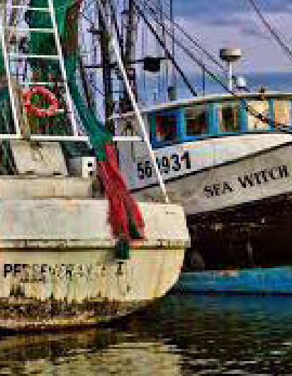
Use this page to highlight case studies where you have heard from different people in your community. Ideally you want to focus on stories where you heard from communities less often heard from.
Better care for fishermen
There are 11,000 fishermen in the UK spending long unsociable hours at sea, which makes it hard for them to use public services. When Healthwatch Kent reached out to hear the experiences of local fishermen, many said getting a GP appointment was difficult because they were at sea during practice opening times. They also avoided making appointments because they wouldn’t get paid for missing work.
Healthwatch Kent recommended that GP opening hours should be extended, and more health check sessions should be held at the local docks to allow fishermen to get the medical checks they needed.
“I could do with going to the GP about my elbow. But nowadays the GP wants you to call at 8:30… I just can’t call at that time. By the time I’m back on shore, all the appointments have been taken.”
Local fisherman
Breaking down barriers to life saving screening
Cervical cancer screenings save around 2,000 lives a year in the UK. But uptake in Bolton was lower than the national average, particularly in Rumworth, an ethnically diverse area, due to religious and cultural reasons.
With the help of local groups, Healthwatch Bolton hosted sessions in the community to break down the barriers. A local mosque was used to hold screenings, creating an environment where women felt comfortable and could speak to health professionals without feeling judged.
Due to the success of the project, women can now access life-saving screenings for cervical cancer and build a trusted relationship with a medical professional they can go to when other health issues arise.
“I did not plan to have my screening test done when I attended the pop-up clinic; however, seeing how helpful the staff were, I decided to have my test done. I felt more comfortable and relaxed than going to my health centre.”
Local resident

Slide 16
Advice and information
Tailor this list of how you have helped people
to the top 4 things you have done during the last year
If you feel lost and don’t know where to turn, Healthwatch is here for you. In times of worry or stress, we can provide confidential support and free information to help you understand your options and get the help you need. Whether it’s finding an NHS dentist, how to make a complaint or choosing a good care home for a loved one – you can count on us.
This year we’ve helped people by:
Providing up to date information people can trust
Helping people access the services they need
Helping people access NHS dentistry
Supporting people to look after their health during the cost of living crisis
Please ensure headings and text do not overlap graphics on the page
To change the photo:
Double-click on the photo.
From the main menu, select: Format > Change Picture.
Delete this box.

Slide 17
Pick two stories about how people came to you for advice and information and how you were able to help / offer support and make a difference. Make sure your case study titles reflect the outcomes of the story so readers know at a glance what you achieved.
Help to find dental care in Leeds
Healthwatch Leeds had 304 people contact them for advice and information on dental services. The public reported to them that most practices were not taking on new patients, and that some had waiting lists of up to five years.
The impact of delayed treatment has resulted in people living with considerable pain, developing medical resistance and dental conditions worsening.
“I’m so embarrassed about my teeth. I can’t leave the house. I’m so depressed about this.”
Shannel, Leeds resident
Healthwatch Leeds’s advice and information has meant people who need urgent treatment know their options and have clear information.
“Thank you for all the information you gathered to help me make an informed choice about treatment for my tooth.”
Lynn, Leeds resident
Section word count – 140 words
Healthwatch Leeds have met regularly and shared information with the Yorkshire and Humber NHS England dental commissioning team and the British Dental Association. They also presented findings to a Scrutiny Board workshop.
Helping residents in poverty cope with rising energy bills
Islington Somali Community partnered with Healthwatch Islington on their Winter Wellness project. Across the partnership they helped over 700 residents, giving out information in a wide range of community languages.
One of the residents who Islington Somali Community supported had been through a difficult time during the pandemic. The family were struggling financially, and the bills kept piling up. She had tried to stay on top of things and most of her bills were paid. However, her energy bills were too much for her, and the amount she owed kept increasing due to extra fines.
Islington Somali Community tried reasoning with her energy provider who demanded the full payment. They eventually said there was nothing they could do because they had passed her account on to debt collectors.
Islington Somali Community found out about Step Change, a specialist debt charity, through Healthwatch at one of our Winter Wellness information briefings.
As a result, they were able to advise their client to apply to Step Change for support. After the client signed up for Step Change, Islington Somali Community contacted her energy provider and managed to set up a repayment plan.
Section word count – 140 words

Slide 18
Volunteering
You can tailor this list with any additional activities that your own volunteers have been carrying out over the last year.
We’re supported by a team of amazing volunteers who are at the heart of what we do. Thanks to their efforts in the community, we’re able to understand what is working and what needs improving.
This year our volunteers:
Visited communities to promote their local Healthwatch and what we have to offer
Collected experiences and supported their communities to share their views
Carried out enter and view visits to local services to help them improve
Reviewed GP and dentist websites to review accessibility
Collected the most up-to-date information on changes to services, such as whether NHS dental appointments were available at a practice
Please ensure headings and text do not overlap graphics on the page
To change the photo:
Double-click on the photo.
From the main menu, select: Format > Change Picture.
Delete this box.

Slide 19
Choose three different stories of ways your volunteers have helped. Be consistent and if you add a picture for one volunteer, make sure you do the same for all of them. The pictures should be the same size and not pixelated.
If you don’t have three stories to showcase, delete one or two of the examples and write one longer case study.
Keep your stories concise – make every word count towards the story of how they have helped make a difference to your community.
Cathy
“Volunteering for Healthwatch has given me skills I can put on my CV when looking for my first job when I finish university later this year. Helping with their social media has taught me so much about campaigns and given me a head start into my new career.”
Section word count – 60 words
Gary
“Helping other people to share their experiences with Healthwatch is so important to me. I did, and my local GP centre changed it opening hours to be more inclusive as a result of patient feedback. People are often surprised when I explain to them that sharing their feedback really does lead to change. I enjoy doing my bit to make sure local services in this area are the best they can be.”
Section word count – 60 words
Susan
“I recently joined the Board and have enjoyed working together with the local Health and Wellbeing Committee to ensure local services are meeting people’s needs. The experiences that Healthwatch collect are invaluable to shaping these conversations to ensure we have a good understand of the needs of the community in our local area.”
Section word count – 60 words
Remember you can write “Healthwatch Anytown website” highlight the text – right click – add link. This will add the link to your text rather than writing out the full URL.
Include your volunteer manager / coordinator details if you have one
Do you feel inspired?
We are always on the lookout for new volunteers, so please get in touch today.
www.healthwatch.org/localname
0123 456 78
Email@email.com

Slide 20
Finance and future priorities
To help us carry out our work we receive funding from our local authority under the Health and Social Care Act 2012.
Our income and expenditure
The figure you give for funding from the local authority should wherever possible be for the statutory Healthwatch service alone. You shouldn’t include in that figure funding you may receive for other services, such as Complaints Advocacy. If your contract doesn’t specify separate amounts then you should add a note to say that the figure includes other services in addition to Healthwatch.
Income |  |  | Expenditure
Annual grant from Government | £3,377,309 |  | Expenditure on pay | £2,089,576
Additional income | £219,929 |  | Non-pay expenditure | £776,448
 |  |  | Office and management fee | £283,362
Total income | £3597,238 |  | Total expenditure | £3,149,386
To add new rows to these right click in them and select ‘Insert’. Choose whether to add rows above or below.
This pull out box is a chance for you to highlight the three areas you intend to focus on next year. You just need to explain what the priority is and how to intend to focus on it.
Additional income is broken down by:
£4,000 funding received from Healthwatch England for work on a project
£800 funding received from a local charity to support their project
Next steps
In the ten years since Healthwatch was launched, we’ve demonstrated the power of public feedback in helping the health and care system understand what is working, spot issues and think about how things can be better in the future.
Services are currently facing unprecedented challenges and tackling the backlog needs to be a key priority for the NHS to ensure everyone gets the care they need. Over the next year we will continue our role in collecting feedback from everyone in our local community and giving them a voice to help shape improvements to services.
We will also continue our work to tackling inequalities that exist and work to reduce the barriers you face when accessing care, regardless whether that is because of where you live, income or race.
You can add any other focuses for your next steps here.
Top three priorities for 2023-24
List your top three priorities for next year
These could include tackling health inequalities further
Or plans to reach areas of the community you currently don’t hear from.

Slide 21
Statutory statements
Please ensure headings and text do not overlap graphics on the page
To change the photo:
Double-click on the photo.
From the main menu, select: Format > Change Picture.
Ensure new picture sits fully behind the green curve, resize if not.
Delete this box.
Healthwatch England, 2 Redman Place, Stratford, E20 1JQ [Include name of company holding local Healthwatch contract if different and any sub contractors].
Healthwatch [insert name] uses the Healthwatch Trademark when undertaking our statutory activities as covered by the licence agreement.

Slide 22
The way we work
Here you should add details of any sub-committees or other meetings which involved board members, volunteers or the wider public making decisions about Healthwatch work.
Keep it clear and concise – a brief explanation is all that is necessary.
You may need to write a few sentences more about how the public are involved in setting your priorities if you know that your funders and other stakeholders are particularly keen to hear about this.
Involvement of volunteers and lay people in our governance and decision-making
Our Healthwatch Board consists of [number] members who work on a voluntary basis to provide direction, oversight and scrutiny to our activities. Our Board ensures that decisions about priority areas of work reflect the concerns and interests of our diverse local community. Throughout 2022/23 the Board met [number] times and made decisions on matters such as [provide two examples of decisions which were made].
We ensure wider public involvement in deciding our work priorities.
Write one sentence for each of the ways information from the public shaped your priorities. For example, one sentence about using insight from information and signposting enquiries and another about public forums or discussions you facilitate when
priority setting.
If you have not used the section titled “Hearing from all communities” you need to add the following to meet your statutory requirements:
We are committed to taking additional steps to ensure we obtain the views of people from diverse backgrounds who are often not heard from. This year we have done this by…
Give a couple of examples as to how you have taken additional steps to ensure you obtain views from diverse backgrounds. This should be explained within a few sentences by a few examples of approaches / partnerships that have been used.
Methods and systems used across the year to obtain people’s experiences
We use a wide range of approaches to ensure that as many people as possible have the opportunity to provide us with insight about their experience of using services. During 2022/23 we have been available by phone, email, provided a webform on our website and through social media, as well as attending meetings of community groups and forums.
We ensure that this annual report is made available to as many members of the public and partner organisations as possible. We will publish it on our website [include details of anywhere else it will be made available].
If you had issues that were escalated to Healthwatch England, then briefly describe them and the results of that.
Responses to recommendations
We had [number] providers who did not respond to requests for information or recommendations. There were no issues or recommendations escalated by us to Healthwatch England Committee, so no resulting reviews or investigations.
Taking people’s experiences to decision makers
We ensure that people who can make decisions about services hear about the insight and experiences that have been shared with us.
In our local authority area for example we take information to [give some examples of committees or other places where you share what you have heard with decision makers at local authority level.]
We also take insight and experiences to decision makers in [name of Integrated Care System]. For example, we [give details of committees or other places where you share information at ICS level and explain where this is in collaboration with Healthwatch in other areas within the ICS]. We also share our data with Healthwatch England to help address health and care issues at a national level.

Slide 23
Enter and view
This year, we made [number] of Enter and View visits. We made [number] recommendations or actions as a result of this activity.
Location | Reason for visit | What you did as a result
GP Practice - Willowbank | Patients raised safety concerns | Wrote a report with recommendations – the service followed up on these and patient safety improved.
To add new rows to these right click in them and select ‘Insert’. Choose whether to add rows above or below. To delete instead choose delete
Healthwatch representatives
Healthwatch [name] is represented on the [name] Health and Wellbeing Board by [provide name and job title]. During 2022/23 our representative has effectively carried out this role by [provide a brief overview of their activities].
Healthwatch [name] is represented on [name] Integrated Care Partnerships by [provide details] and [name] Integrated Care Boards by [provide details]. [If you have a seat within any other system level body mention them here]
Describe your role on the Health and wellbeing board by briefly explaining your role. This should be a sentence per role and keep it concise by explaining the bigger parts of the role, not the day to day detail.
The legislation about Healthwatch annual reports only requires details on representation on the Health and Wellbeing Board, however it is recommended to include details of Integrated Care Systems.
This table should be used to provide a summary list of projects and pieces of work undertaken over the year which you haven’t chosen as one of those to feature with a fuller account in the main early sections of the report. This is a chance to ensure you report on outcomes you’ve achieved which might otherwise be overlooked, whilst still keeping the overall report succinct and readable.
Against each priority area of work in the table, provide a very short description of changes or improvements to the commissioning and provision of services up to the end of March 2023.
2022–2023 Outcomes
Project / activity | Changes made to services

Slide 24
Healthwatch England National Customer Service Centre Citygate Gallowgate Newcastle upon Tyne NE1 4PA
www.healthwatch.co.uk
t: 03000 683 000
e: enquiries@healthwatch.co.uk
Don’t forget to replace these contact details and social media links with those for your own Healthwatch
@HealthwatchE
Facebook.com/HealthwatchE
X
X

Slide 25
Please delete this slide when you’ve finished.
Annual report template 2022-23
Powerpoint version
Read and delete this page before publication
About this template
Your annual report is a chance for you to report on your statutory activities over he last year. You should show how your work has made a difference to the commissioning, provision and management of health and social care services in your area.
We know that it can be hard to showcase the impact of our work - quite often it doesn't fit into one annual year. This template gives you a suggested structure for your annual report to help showcase your impact from projects over time and takes into account the legislation that sets out the information you are required to include.
Don’t forget to talk about how you work to champion the voices of patients and your community with leaders and decision makers in your local NHS and at ICS level.
Supporting resources
You can download the following resources from the Communications Centre You will need to log in to download the template, there is only one log in per Healthwatch.
If you need help accessing the communications centre, please contact hub@healthwatch.co.uk
A PowerPoint version of the template.
An InDesign version of the template.
A range of graphics to help showcase your work visually.
You can also access a range of images via our Photo library.
Using our design font Poppins
This template has been designed using our design font ’Poppins’. This is a Google font and easy to download at no cost. However, you will need to install it on your computer before you can use it.
Download Poppins from Google fonts

Slide 26
Please delete this slide when you’ve finished.
Guidance This guidance has been written for PowerPoint 2010. We have also included guidance throughout the document in pink boxes, which should be deleted.
The template has already been populated with key content to help guide you. Simply overwrite the text with the content relevant to your local Healthwatch.
Pre-set style slides We have created a selection of slide styles that should cover what you need to include in your annual report. Within these set styles there is enough flexibility to change elements or to retain them depending on how you want to present the annual report. The template already has the Healthwatch colours added to keep your report on brand.
The master slides To make sure things stay in place while you use the template, we’ve used master slides to create a selection of slide styles. These will ensure you can format your text consistently and include set styles..
We recommend that you don’t change any of the master slides but choose a slide style appropriate for the information you need to write and change elements within that slide.
Covers There are two cover options to choose from. Select one and delete the other before publication. You should update the cover and back page with your own logo and image. Logo guidance is given in the pink box on the cover pages.

Slide 27
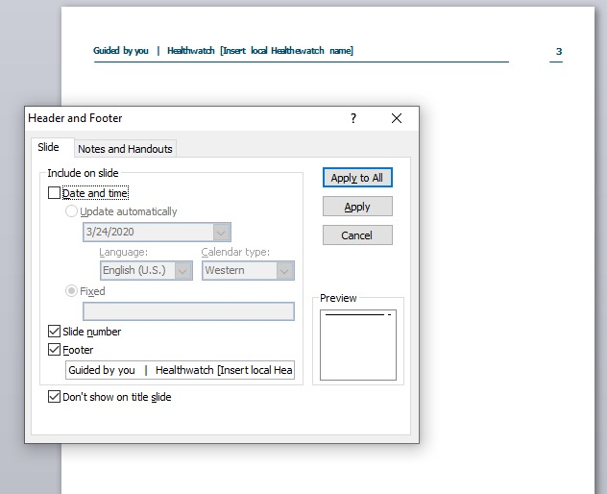
Please delete this slide when you’ve finished.
Changing the header To add your local Healthwatch name to the footer, click on the Insert tab or Insert at the top of your page to give you the drop-down menu. Click Header & Footer. In the text box type in your local Healthwatch name and delete [insert your local Healthwatch]. Click Apply to all. Remember: Don't forget to remove the brackets around your local Healthwatch name or they will appear on the page.
Fonts Throughout the template Poppins is used for both headings and body copy. To download this visit Google Fonts
Adding and removing pages To add a page: Click on the New Slide tab and choose a pre-styled slide from the drop-down menu or alternatively at the bottom of the drop-down menu is the option to choose a duplicate slide.
To remove a page: Choose the slide you want to delete from the left-hand navigation bar in Normal view and press the delete key.

Slide 28
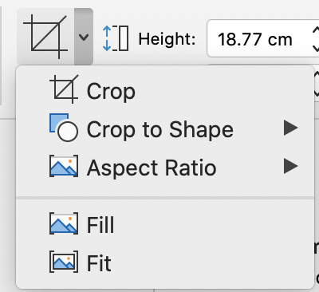
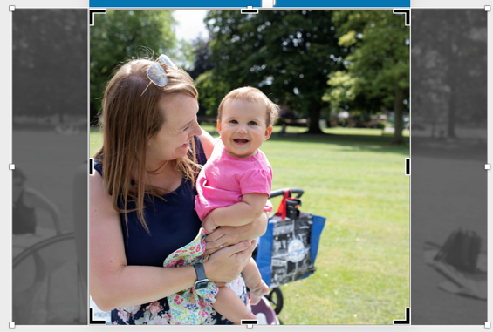
Please delete this slide when you’ve finished.
Images We have included sample images throughout the template, but you can also personalise the report by using your own photography or downloading other images from our photo library on Flickr.
If you plan to print the report, you should use high resolution images that are at least 300dpi. (See section on Compressing images)
To change an image or add an image Delete the current photo > go to insert > click on the picture button > choose picture from file.
When you double click onto your image the picture format toolbar will appear for you to edit, crop and resize images. You can also resize images by dragging the corner of the picture. However, you should always hold down the shift key when you do this to ensure the image doesn’t stretch or get distorted in any way.

Slide 29
Please delete this slide when you’ve finished.
Compressing images Compressing images allows you to share your report easily with others and online.
Click on your image
Click the Picture Tools Format tab
Click Compress Pictures
Select your Compression options and ensure the Apply to all pictures in this file is checked
Click OK
If your report is to be shared only online choose the On-screen (150ppi) option.
If your report is to be printed externally you should not compress the images, but ensure you download the original version from the Flickr library.

Slide 30
Please delete this slide when you’ve finished.
Using infographics, pull-out boxes and quotes To make the report engaging for people, we’ve included a number of graphic elements.
We’ve shown examples of how to use these throughout the template. These are not created in the slide master and therefore can be moved, deleted, cut and pasted on to other slides.
To move a graphic on a slide, click on it and drag it to where you want to place it. To resize a graphic, hold down shift key and drag the corners.
Quotes style
Infographic style
To download Healthwatch graphics visit our Communications Center.
“I need information on transport for someone attending regular dialysis. They can’t travel on public transport. It would require two buses and they are too ill. They also do not have anyone who can drive them there.”

Slide 31
Please delete this slide when you’ve finished.
How to save the PowerPoint as a PDF for publication Once you’re happy with your annual report, delete the guidance pages and boxes, and any covers you aren’t using. Next, click on file > save as > choose PDF document from the drop menu.
Remember: Make sure all your page numbers are correctly displayed in the contents page, that your hyperlinks work, and that your references are correct.
Setting the document for print If you plan to print the report, you should use high resolution images that are at least 300dpi. To make sure you have the correct resolution download the original version of the image from the Flickr library.
If you would like to print as a booklet, ensure your pages are multiples of four, e.g. 12, 16 or 20 pages.
For online versions of the report download the Large (2048 x 1360) option of your chosen image.
Remember: Choose the correct compression resolution for your images if you’re sharing it online. (See Compressing images section).
Ensure your content is in plain English
Before you finalise your document, it is a good idea to make sure that you have used accessible language, and that your words are clear and readable. There are a number of tools that can help you:
1. Guidelines:
New brand guidelines
Our tone of voice guidance
2. Online tools such as:
https://rewordify.com
https://www.grammarly.com
Hemingway app
Readability Test Tool
Plain English Campaign
Contact If you have any difficulties using the template please contact the team at: hub@healthwatch.co.uk

