Slide 1
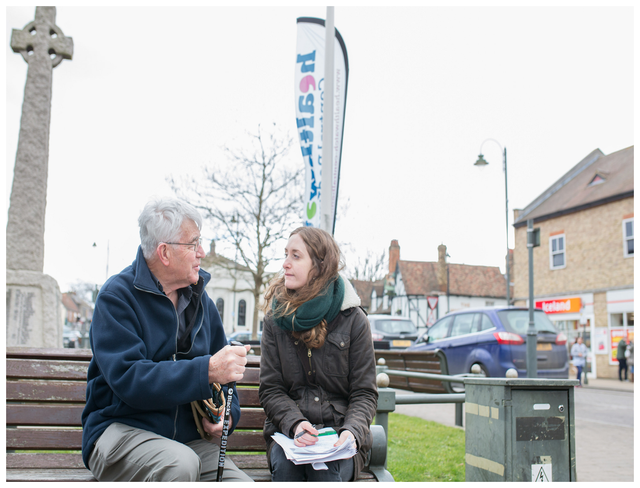
Enter & View Training
Training Session:
[Insert date and trainer]

Slide 2
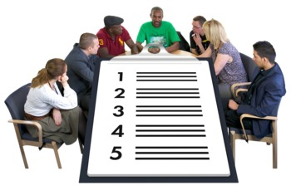
Before we start...
Housekeeping
Ground Rules
Aims
Introductions

Slide 3
Housekeeping Ground Rules
Fire exits and alarms
Toilets
Lunch and breaks
Value everyone’s opinion
One person at a time
Say if you don’t understand
Agree to disagree
No jargon!
Keep to time
Make your point as short as you can
We want to hear from everyone!
Phones on silent

Slide 4

Aim of this session
By the end of today you will:
Understand what Enter and View (E&V) is and is not
Understand the legal framework of E&V
Have looked at different situations
Know when it is not appropriate to use E&V
Know how to prepare and carry out a visit
Deal with difficult situations
Prepare an E&V Report
Understand the importance of E&V
Share and discuss examples of good practice

Slide 5
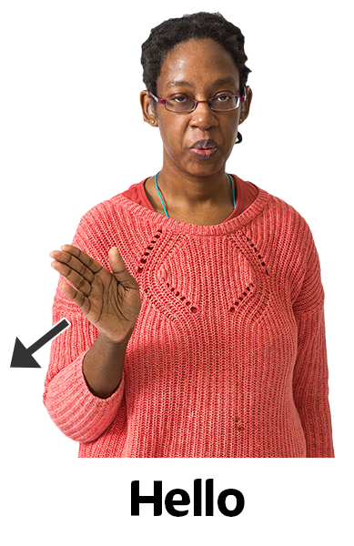
Introductions
Please introduce yourself
Tell us one thing you want to take away from the session today?

Slide 6


Setting the Scene
This training session will cover before, during and after an E&V Visit
Lots of Healthwatch have other training they provide
Other training:
      Equality & Diversity
      Confidentiality (Data Protection)
      Safeguarding for Adults

Slide 7
5 Ws Approach
What?
is Enter & View
Who?
can do an Enter & View visit?
Where?
can be Entered & Viewed?
Why?
is Enter & View important?
When?
is Enter & View not appropriate?
is Enter & View NOT

Slide 8
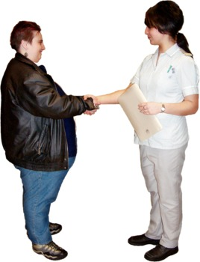
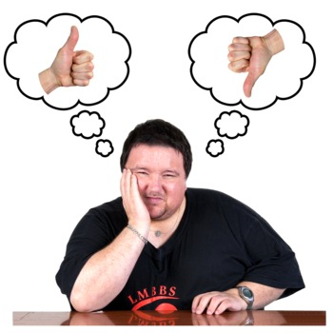
What is Enter & View?
    Visiting health and social care premises to understand how services are provided
    Finding out people’s views
    Finding out about the quality of services
    Making observations (using all your senses)
    Gathering evidence-based findings
    Reporting findings – good and bad
    Making recommendations

Slide 9
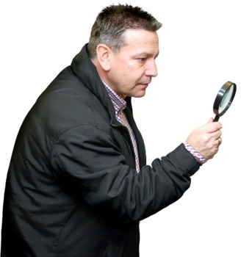

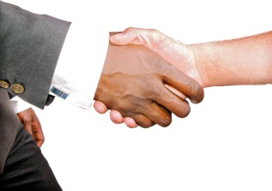

What is Enter & View NOT?
An inspection:
Although others might think it is!
A standalone activity:
Enter and View is just a tool
You should work with other organisations to help them improve
It should not be a last resort
It should not be the first choice
It should be planned and have a clear reason

Slide 10
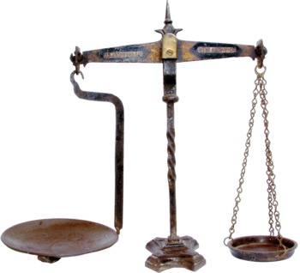
The Laws and Regulations behind E&V
The Local Government and Public Involvement in Health 2007 (amended via the Health & Social Care Act 2012)
[makes Enter & View possible]
The Local Authorities (Public Health Functions and Entry to Premises by Local Healthwatch Representatives) Regulations 2013
[makes sure service providers allow Healthwatch entry to observe activities]

Slide 11


Who can Enter & View?
  Only Authorised Representatives can do visits and only when asked to do so by their Healthwatch
  All local Healthwatch organisations can have Authorised Representatives able to carry out visits
  Authorised Representatives should have been recruited, trained and have a current DBS check
  Each Healthwatch must publish a full and up to date list of its Authorised Representatives

Slide 12
Where can we Enter & View?

Slide 13



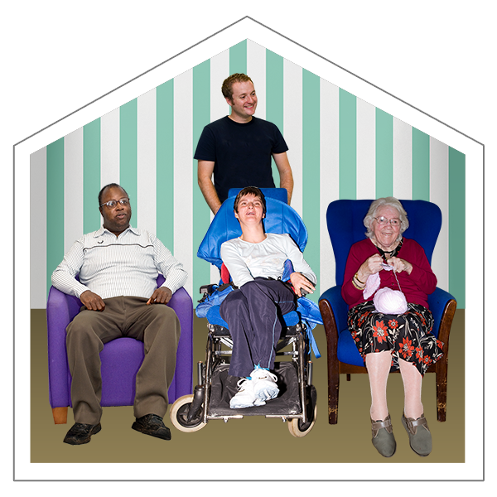
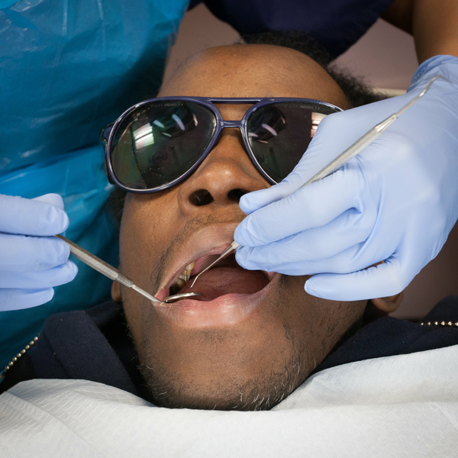

Where can we Enter & View?
Doctors Hospitals Day
surgeries and clinics centres
Care homes Dentists Opticians and pharmacies

Slide 14
Why is Enter & View important?

Slide 15

Why is Enter & View important?
Enter & View can:
give seldom heard people a voice
gather more detailed information
help with joint working
provide more evidence
identify best practice

Slide 16
Exercise
When would it not be suitable to Enter & View?
Enter & View
Notes:
Handout

Slide 17
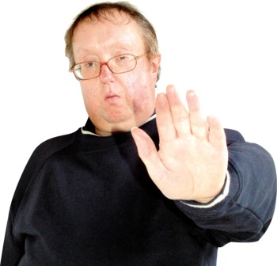

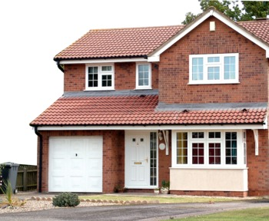
When not to E&V
When the law does not apply:
    Compromises provision of a service
    Compromises privacy or dignity of anybody
    Authorised representative is not acting fairly
    Authorised representative does not show ID
    Children’s social care settings
    In buildings that are:
    A person’s own home
    Used only as accommodation for employees
    Parts of care homes that are not shared
    Not providing care services
    Closed

Slide 18

Short Break

Slide 19

Preparing for a Visit
What information will you need before carrying out a visit?

Slide 20




Preparing for a Visit
Why did Healthwatch decide to carry out the E&V?
What will you be looking for?
What pre-visit information will you send to the service?
What do you already know about the service? (5 Ws)
What views do people have about the service?
What information is publicly available?
Practical arrangements for the visit

Slide 21
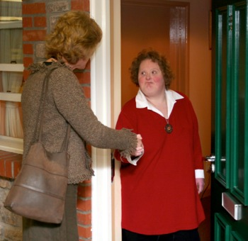

Understanding the Purpose
  Each visit should have a reason.
  Providers will be more welcoming if they understand why you are there.
  Do not try to do too much in one visit.
  Visits should be done by priority.
  Involving other organisations can be useful.
  Healthwatch will decide where and who should visit.
  Makes writing the report easier.

Slide 22

Case Study Exercise
Read through the case study and complete the boxes; (What? Who? Where? Why? When?)

Slide 23

What should a Code of Conduct look like?

Slide 24
Code of Conduct
Dress suitably
Do not accept gifts
Introduce yourself to people
Get people’s agreement before talking to them
Apply the Seven Principles of Public Life (the Nolan Principles):
      Selflessness
      Integrity
      Objectivity
      Accountability
      Openness
      Honesty
      Leadership

Slide 25

Being inclusive

Slide 26
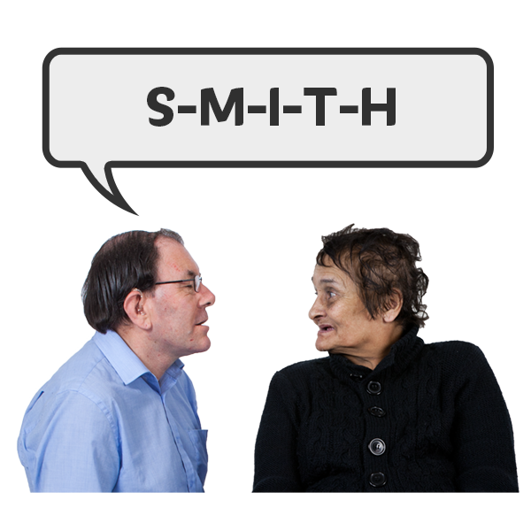




What can I do?
Names are important
Ask someone how they pronounce their name – and practice!
Pronouns are important
Being misgendered can have a negative impact on your mental health. Ask someone (privately) how they prefer to be addressed. Try not to make assumptions.
Remember, there is a difference between nationality and ethnicity.
Ask: Where are you from? – accept the answer
Don’t add the ‘where are you really from originally?’
If you get it wrong – apologise

Slide 27
Are ‘microaggressions’ really that tiny?
“But where are you really from?”
Said to a British person of African descent who said they were British when asked their nationality.
Said to an older person when they have offered to help with a new work project.
Said to a pregnant woman at work by her manager before she went on maternity leave.
“You might have trouble learning the new technology.”
“I expect your priorities will change now.”

Slide 28
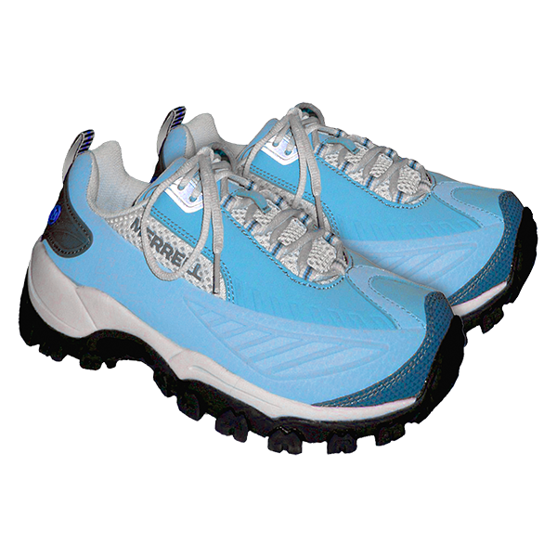

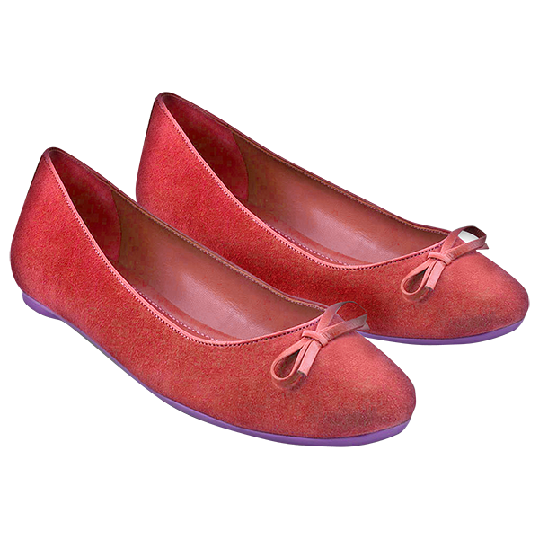
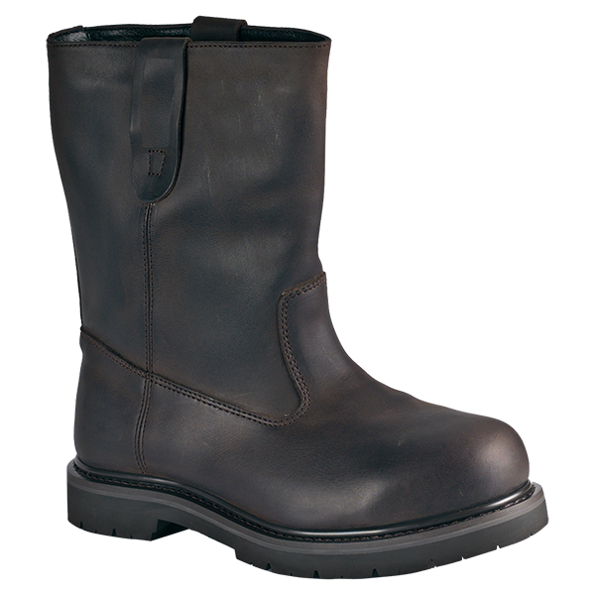
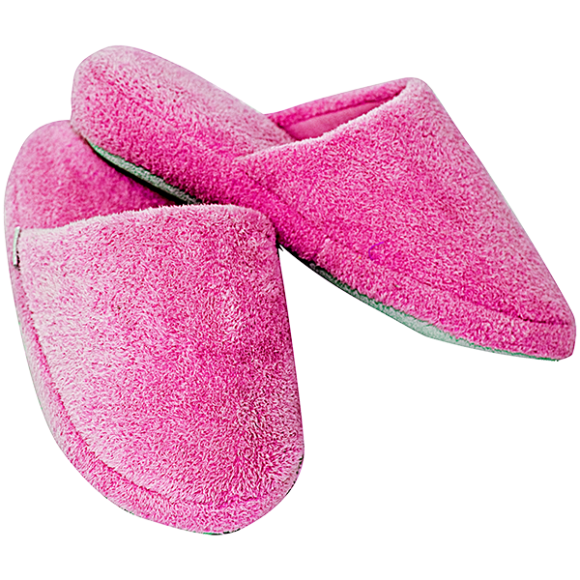
Remember:
Equality - everyone gets a pair of shoes.
Diversity - everyone gets a different type of shoe.
Equity - everyone gets a pair of shoes that fits.
Acceptance - understanding we all wear different kinds of shoes.
Belonging - wearing the shoes you want without fear of judgement.

Slide 29
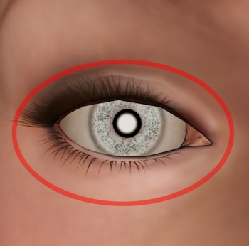
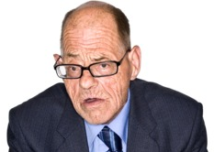
Making Observations
Enter & View is about Authorised Representatives seeing things for themselves

Slide 30
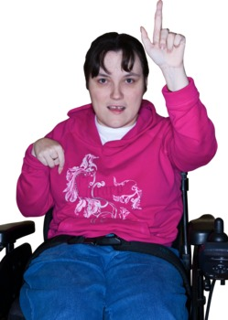
Good Listening Skills
Can I just check something with you...
Look interested
Pay attention
Don’t make assumptions
Encourage
Listen
Check it out
Summarise

Slide 31
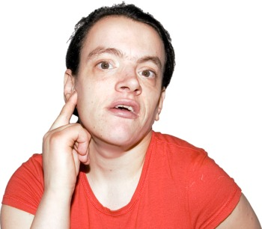
Listening Skills
It is important for Authorised Representatives to have good listening skills
LISTENING PRACTICE EXERCISE

Slide 32
Does your drawing look like this...?

Slide 33


Listening skills: remember!
DO
Encourage:
“Yes”
“Tell me more”
“Go on”
“Please continue”
Nod
Make sure
Restate
Summarise
“So, what you’re saying is.”
DON’T
Judge
Argue
Evaluate
Give your opinion
Give advice

Slide 34

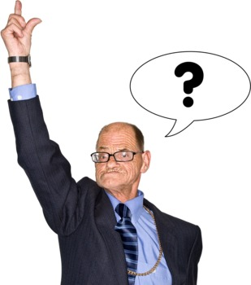
Asking Questions
What is a closed question?
What is an open question?

Slide 35
Questioning Skills
Closed questions limit the answer
Open questions encourage people to talk
Have you enjoyed your day?
Yes
Tell me about what you’ve done today...
I arrived at 9’o’clock and the first thing I did was...

Slide 36
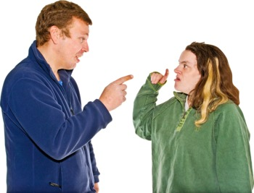
Dealing with difficult situations
In pairs think about when you have had to deal with a difficult situation and talk about how you dealt with it.

Slide 37
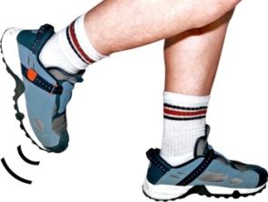
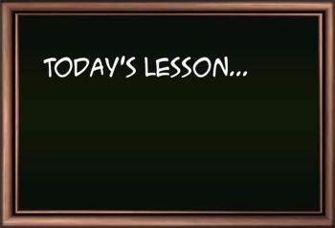
Six steps to managing difficult situations
1. Take a step back
2. Understand the other view
3. Think about your needs
4. Reflect
5. Share your learning
6. Move on
My Needs

Slide 38


Lunch Break

Slide 39

Exercise
What information should be in an Enter & View report?

Slide 40
The Report Should Include...
What you were told
What you saw
A wide range of views
Good and bad
Accurate information
Sources of information
Anonymous comments
Anything you were unable to find out
Useful comments and recommendations
Do not include your own views unless you can back them up with evidence

Slide 41
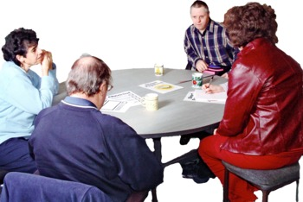

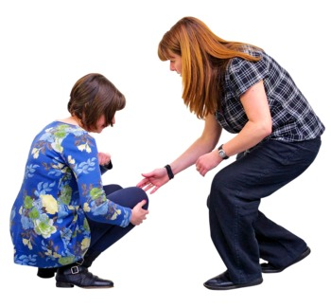
After Visit Process 1
Meet as a team to talk about the visit
Get more information from the provider if needed
Get support from other organisations if needed

Slide 42



After Visit Process 2
Draft report written
Draft report checked
Draft report sent to provider for their comments within 30 days
DRAFT
✓

Slide 43


After Visit Process 3
Follow up with provider if no comments within 20-30 days
Report changed to include providers comments and recommendations they have agreed to
Final report shared with provider within 10 working days of receiving their comments

Slide 44


After Visit Process 4
Final report shared with everybody involved
Report published on our website
Visit closed
VISIT CLOSED

Slide 45
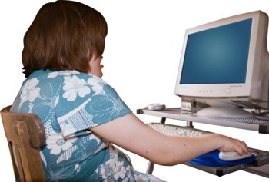

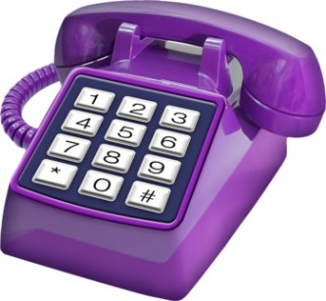
After Visit Process 5
Visit details logged with local Healthwatch and sent to Healthwatch England
Visit reviewed & evaluated
Follow up with provider if needed

Slide 46

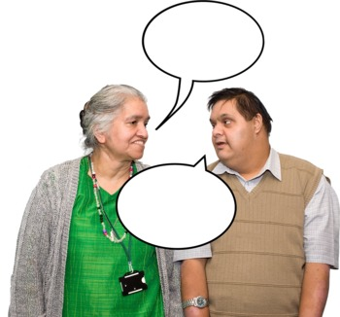
Further Healthwatch Activity
Healthwatch decides how to use information gained from a visit
Findings could be:
Reported to a statutory body such as the Care Quality Commission, the local Health Scrutiny Committee or Health & Wellbeing Board.
Discussed at a steering/task group meeting.
Publicised through a press release.
Talked about with local groups or at a public meeting.
Used to decide what future work is needed.
Used to answer future consultations.
This might mean another visit is needed.

Slide 47
Recap: What have we learnt?
Enter & View is not an inspection
Visits can only be completed by Authorised Representatives
There are times and places when Enter & View is not appropriate
There should be a clear reason for a visit

Slide 48



Recap: What have we learnt?
Discussed how to gather information
Understood how important observations are
Understood when to use open or closed questions
Discussed dealing with conflict

Slide 49



Recap: What have we learnt?
You must follow a process after a visit
The report needs to have a wide range of accurate information including good and bad points
Authorised Representative must not give their own opinions without evidence
There are many things that can happen after a visit

Slide 50
Congratulations!
Next steps:
Please fill in the evaluation form to tell us what you think and hand it in to the trainer before you leave
Sign off – Healthwatch will need to sign you off as an Authorised Representative
ID badges – we will need a photograph for your badge
DBS check to be completed
First visit!

