Slide 1
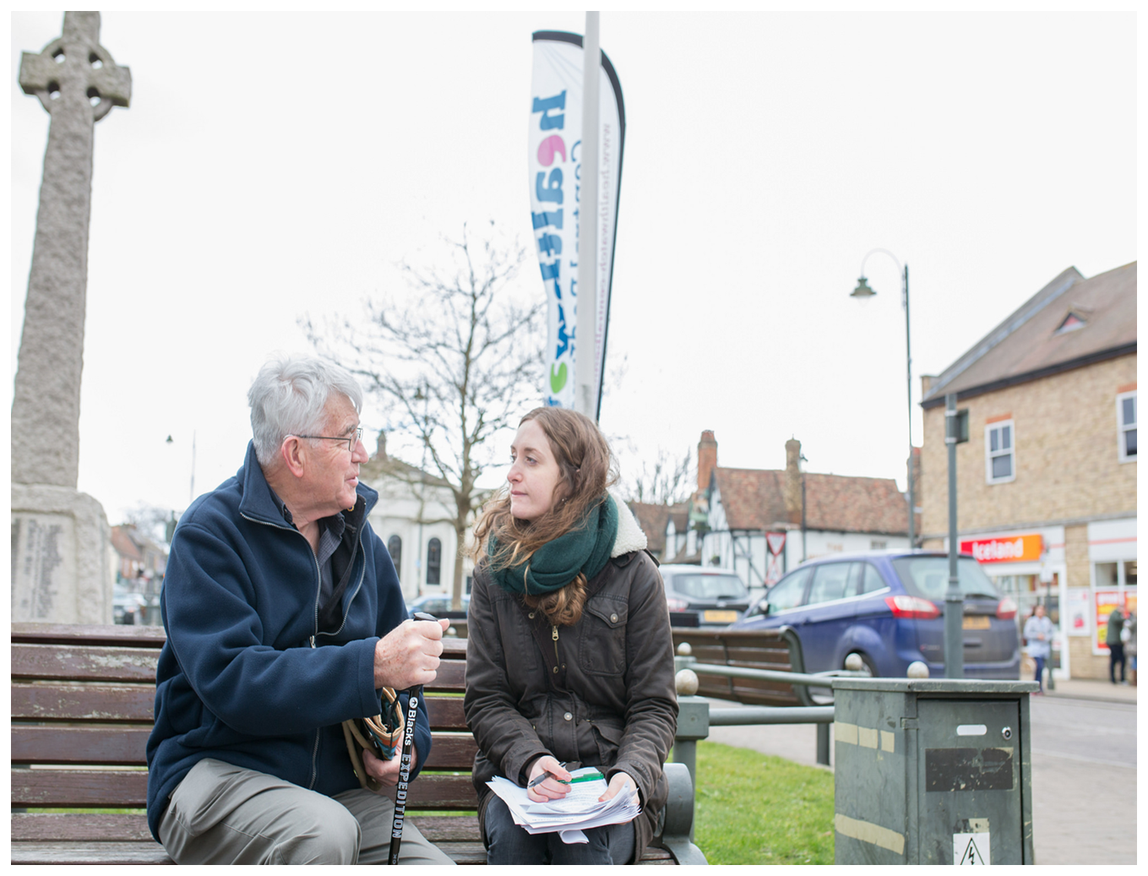
Enter & View Training
Training Session:
[Insert date and trainer]

Slide 2
Agenda
Welcome and Introductions (Housekeeping, Ground Rules, Aims)
Session 1: Before the Visit: 5 Ws approach (What? Who? Why? Where? When?)
Situations exercise
Break
Session 2: During the Visit (Nolan Principles, Code of Conduct,
Listening Skills, Making Observations, Do’s and Don’ts)
Lunch Break
Session 3: After the Visit: (What should go in the report? What happens after the visit?)
Session 4: Further Healthwatch Activity and Recap
Close

Slide 3
Housekeeping Ground Rules
Online platform
Stay on mute when you aren’t speaking
Use hands up function when you want to speak
Keep your camera on if possible
Join from a quiet space
Lunch and breaks
Value everyone’s opinion
One person at a time
Say if you don’t understand
Agree to disagree
No jargon!
Keep to time
Make your point as short as you can
We want to hear from everyone!
Phones on silent

Slide 4

Aim of this session
By the end of today you will:
Understand what Enter and View (E&V) is and is not
Understand the legal framework of E&V
Have looked at different situations
Know when it is not appropriate to use E&V
Know how to prepare and carry out a visit
Deal with difficult situations
Prepare an E&V Report
Understand the importance of E&V
Share and discuss examples of good practice

Slide 5
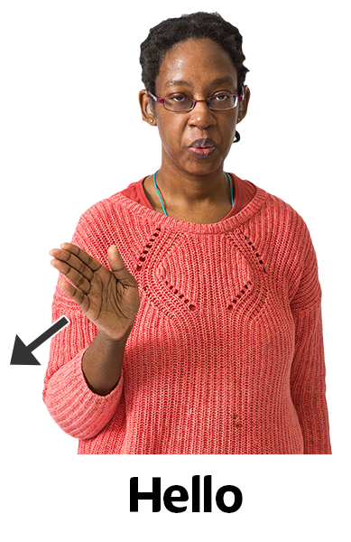
Introductions
Please introduce yourself in the chat
Tell us one thing you want to take away from the session today?

Slide 6


Setting the Scene
This training session will cover before, during and after an Enter & View visit
Lots of Healthwatch have other training they provide
Other training:
      Equality, Diversity and Inclusion
      Confidentiality (Data Protection)
      Safeguarding for Adults

Slide 7
5 Ws Approach
What?
is Enter & View
Who?
can do an Enter & View visit?
Where?
can be Entered & Viewed?
Why?
is Enter & View important?
When?
is Enter & View not appropriate?
is Enter & View NOT

Slide 8
What is Enter & View?

Slide 9
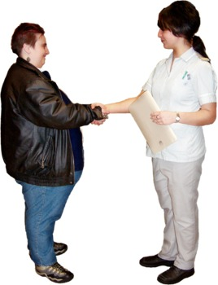
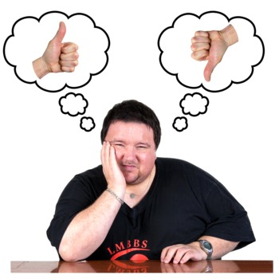
What is Enter & View?
    Visiting health and social care premises to understand how services are provided
    Finding out people’s views
    Finding out about the quality of services
    Making observations (using all your senses)
    Gathering evidence-based findings
    Reporting findings, both good and bad
    Making recommendations

Slide 10
What is Enter & View NOT?

Slide 11
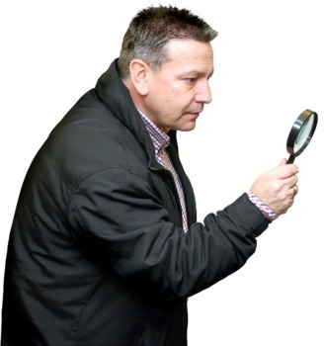



What is Enter & View NOT?
An inspection:
Although others might think it is!
A standalone activity:
Enter and View is just a tool
You should work with other organisations to help them improve
It should not be a last resort
It should not be the first choice
It should be planned and have a clear reason

Slide 12
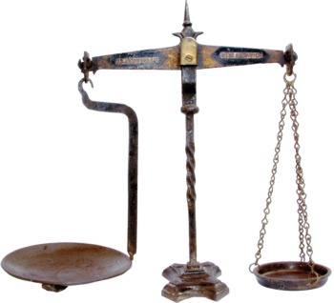
The Laws and Regulations behind E&V
The Local Government and Public Involvement in Health 2007 (amended via the Health & Social Care Act 2012)
[makes Enter & View possible]
The Local Authorities (Public Health Functions and Entry to Premises by Local Healthwatch Representatives) Regulations 2013
[makes sure service providers allow Healthwatch entry to observe activities]

Slide 13
Who can Enter & View?

Slide 14


Who can Enter & View?
  Only Authorised Representatives can do visits and only when asked to do so by their Healthwatch
  All local Healthwatch organisations can have Authorised Representatives who are able to carry out visits
  Authorised Representatives should have been recruited, trained and have a current DBS check
  Each Healthwatch must publish a full and up to date list of its Authorised Representatives

Slide 15
Where can we Enter & View?

Slide 16



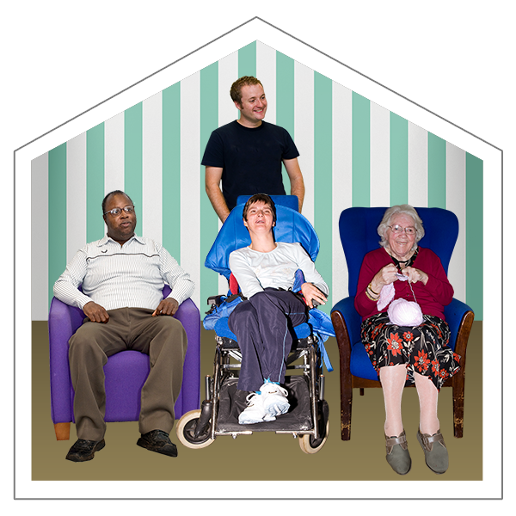
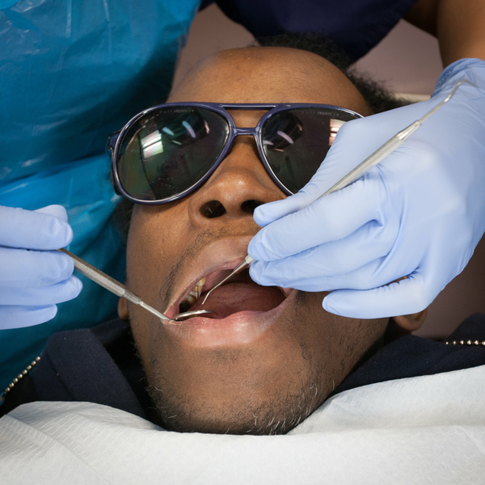

Where can we Enter & View?
Doctors Hospitals Day
surgeries and clinics centres
Care homes Dentists Opticians and pharmacies

Slide 17
Why is Enter & View important?

Slide 18

Why is Enter & View important?
Enter & View can:
give seldom heard people a voice
gather more detailed information
help with joint working
provide more evidence
identify best practice

Slide 19
When would it not be suitable to Enter & View?
Enter & View

Slide 20
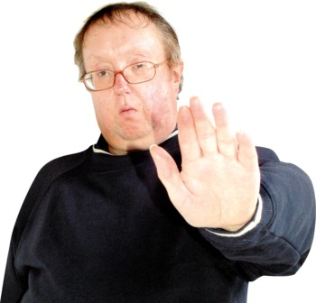

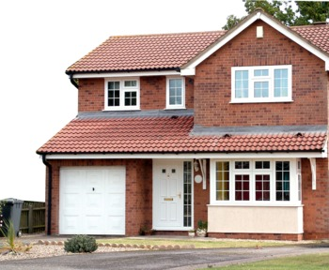
When not to E&V
When the law does not apply:
    Compromises provision of a service
    Compromises privacy or dignity of anybody
    Authorised representative is not acting fairly
    Authorised representative does not show ID
    Children’s social care settings
    In buildings that are:
    A person’s own home
    Used only as accommodation for employees
    Parts of care homes that are not shared
    Not providing care services
    Closed

Slide 21
Situations Exercise
Listen to the following situations and think about how you would respond as an Authorised Representative.

Slide 22

You have arrived at a local hospital ready to carry out an Enter & View visit in the A&E department.
Staff are very busy dealing with a major incident involving 50 people.
Do you:
Carry on with the visit making sure that you don’t get in the way.
Stop the visit.
Ask if there’s anything you can do to help.

Slide 23

You and another Authorised Representative are trying to organise a visit to a local dental surgery next Wednesday.
The dentist closes at 1pm every Wednesday and the other Authorised Representative can only make an afternoon appointment.
What would you do?

Slide 24
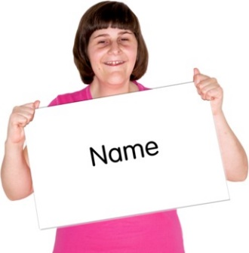
You arrive at a residential care home, ready to begin a planned Enter & View visit with two other Authorised Representatives.
One of your colleagues has forgotten their ID badge but believes it is not a problem as their name has already been given to the care home.
What would you do?

Slide 25
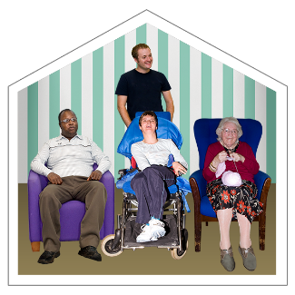
You are due to visit a home care agency.
As part of your visit the manager tells you they have organised for you to go on some home visits with one of their care workers.
Do you:
Go along without a second thought.
Ask for more information about what the shadowing will include.
Check that service users have agreed to you being there.
D. Refuse to go.

Slide 26
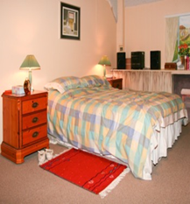
You are visiting a care home and ask to talk with a service user.
The manager agrees and tells you to chat with them in their room while they get ready for bed.
What would you do?

Slide 27
Your Healthwatch has received several concerns from families and visitors about a local children’s home.
Relatives are concerned about poor communication and lack of staffing.
What would you do?

Slide 28

Short Break

Slide 29

What should a Code of Conduct look like?

Slide 30
Code of Conduct
Dress suitably
Do not accept gifts
Introduce yourself to people
Get people’s agreement before talking to them
Apply the Seven Principles of Public Life (the Nolan Principles):
      Selflessness
      Integrity
      Objectivity
      Accountability
      Openness
      Honesty
      Leadership

Slide 31
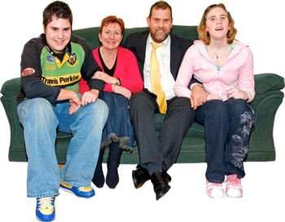

Nolan Principles
Selflessness
Acting only in the interest of the public and not to gain any benefit for yourself, family or friends.
Integrity
Not being put under any pressure by people outside of Healthwatch or other organisations that might want to influence Healthwatch in any way.

Slide 32
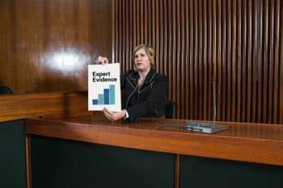
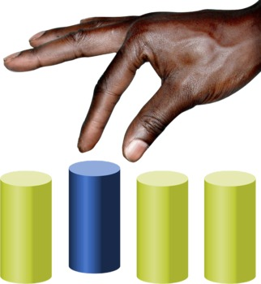
Nolan Principles
Objectivity
Making decisions based on proof
Accountability
Being responsible and answerable for your own decisions and actions
Honesty
Stating any personal interests you have and taking steps to sort conflicts in a way that protects the public’s interest

Slide 33
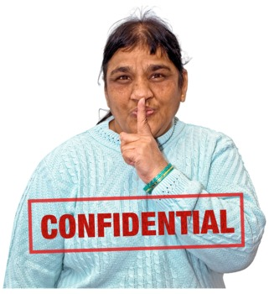

Nolan Principles
Openness
Being open about your decisions and actions and able to give reasons for them.
Only keeping information private when it’s in the public interest to do so.
Leadership
Leading by example and supporting these ideas

Slide 34

Preparing for a Visit
What information will you need before carrying out a visit?

Slide 35




Preparing for a Visit
Why did Healthwatch decide to carry out the E&V?
What will you be looking for?
What pre-visit information will you send to the service?
What do you already know about the service? (5 Ws)
What views do people have about the service?
What information is publicly available?
Practical arrangements for the visit

Slide 36
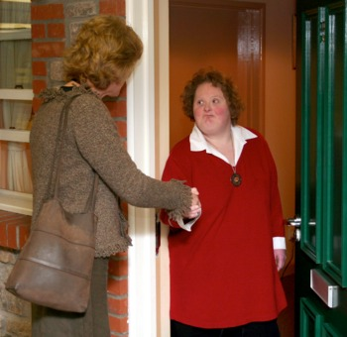

Understanding the Purpose
  Each visit should have a reason.
  Providers will be more welcoming if they understand why you are there.
  Do not try to do too much in one visit.
  Visits should be done by priority.
  Involving other organisations can be useful.
  Healthwatch will decide where and who should visit.
  Makes writing the report easier.

Slide 37

Case Study: Tip – Take notes!
Elfwood Park
As part of the yearly work programme your Healthwatch has planned several enter and view visits to local older people’s care homes.
The reason for the visits is to find out what services and what quality of care is being provided locally.
You are due to visit Elfwood Park Older People’s Home at 10am this Friday.

Slide 38
Case Study: (Take notes!)
Elfwood is a large care home:
The main building has 87 (single and double) rooms with private bathrooms, two shared lounges, five large, shared bathrooms, a dining room and a conservatory.
Residents have access to a restaurant which is open to residents and the public for lunch.
There is a building for office workers and staff meetings.
There are several storage buildings and a shared garden which the residents enjoy.

Slide 39
WHY is a visit needed? (Reason)
WHAT are you going to be looking for? (Evidence)
WHO will it be useful to talk to?
WHERE will you want to see?
WHEN planning for the visit what are you going to want to find out? (Preparation & Research)
Case Study Exercise:
(the reason for the notes!)

Slide 40

Being inclusive

Slide 41
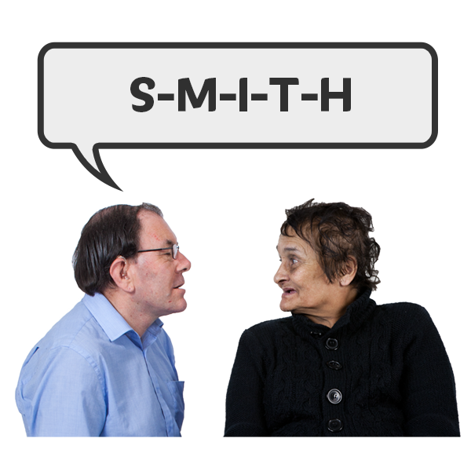




What can I do?
Names are important
Ask someone how they pronounce their name – and practice!
Pronouns are important
Being misgendered can have a negative impact on your mental health. Ask someone (privately) how they prefer to be addressed. Try not to make assumptions.
Remember, there is a difference between nationality and ethnicity.
Ask: Where are you from? – accept the answer
Don’t add the ‘where are you really from originally?’
If you get it wrong – apologise

Slide 42
Are ‘microaggressions’ really that tiny?
“But where are you really from?”
Said to a British person of African descent who said they were British when asked their nationality.
Said to an older person when they have offered to help with a new work project.
Said to a pregnant woman at work by her manager before she went on maternity leave.
“You might have trouble learning the new technology.”
“I expect your priorities will change now.”

Slide 43
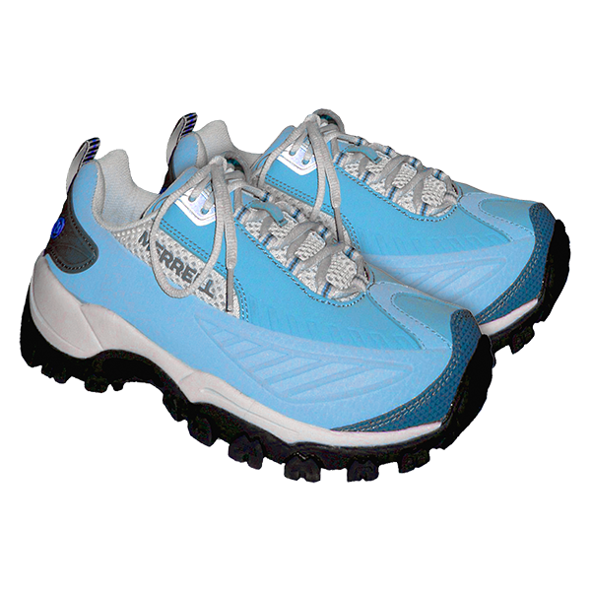

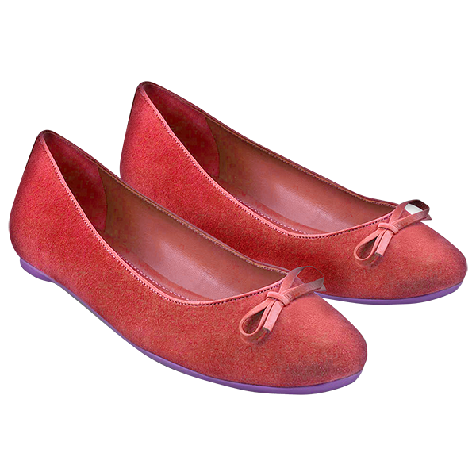
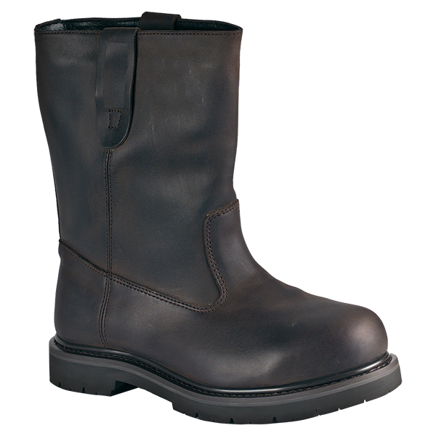
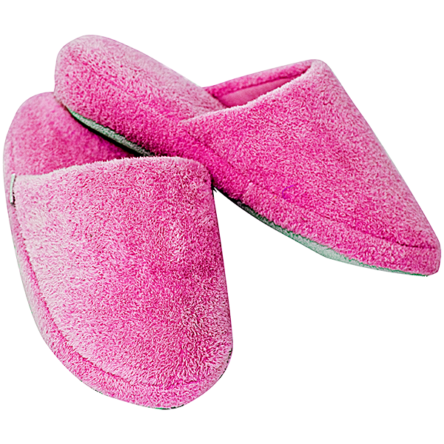
Remember:
Equality - everyone gets a pair of shoes.
Diversity - everyone gets a different type of shoe.
Equity - everyone gets a pair of shoes that fits.
Acceptance - understanding we all wear different kinds of shoes.
Belonging - wearing the shoes you want without fear of judgement.

Slide 44
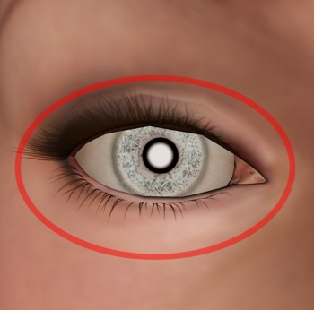
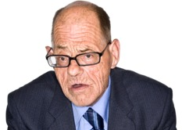
Making Observations
Enter & view is about Authorised Representatives seeing things for themselves

Slide 45
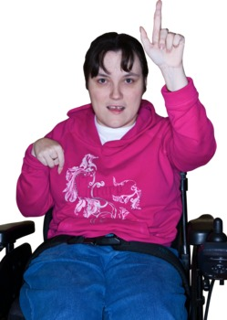
Good Listening Skills
Can I just check something with you...
Look interested
Pay attention
Don’t make assumptions
Encourage
Listen
Check it out
Summarise

Slide 46
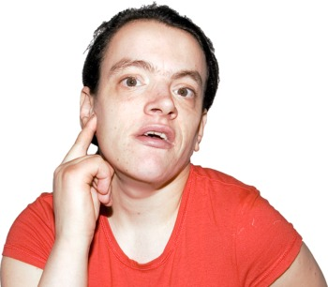
Listening Skills
An important skill for Authorised Representatives is good listening skills
Listening practice exercise

Slide 47
Does your drawing look like this...?

Slide 48


Listening skills: remember!
DO
Encourage:
“Yes”
“Tell me more”
“Go on”
“Please continue”
Nod
Make sure
Restate
Summarise
“So, what you’re saying is.”
DON’T
Judge
Argue
Evaluate
Give your opinion
Give advice

Slide 49

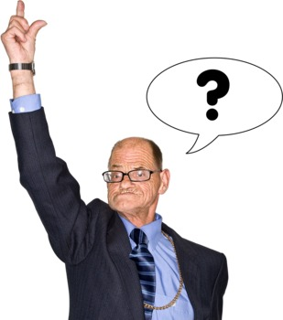
Asking Questions
What is a closed question?
What is an open question?

Slide 50
Questioning Skills
Closed questions limit the answer
Open questions encourage people to talk
Have you enjoyed your day?
Yes
Tell me about what you’ve done today...
I arrived at 9’o’clock and the first thing I did was...

Slide 51

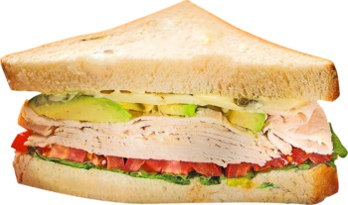
Lunch break

Slide 52
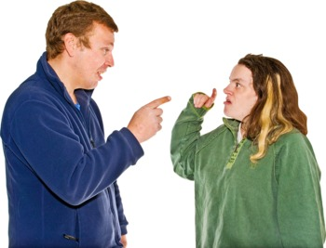
Dealing with difficult situations
Think about when you have had to deal with a difficult situation and how you dealt with it. Would anyone like to share?

Slide 53
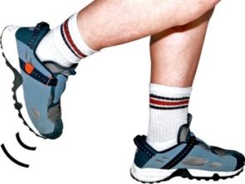
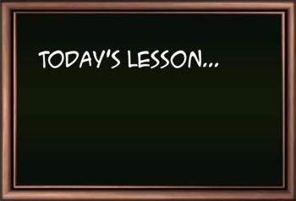
Six steps to managing difficult situations
1. Take a step back
2. Understand the other view
3. Think about your needs
4. Reflect
5. Share your learning
6. Move on
My Needs

Slide 54

Exercise
What information should be in an Enter & View report?

Slide 55
The Report Should Include...
What you were told
What you saw
A wide range of views
Good & bad
Accurate information
Sources of information
Anonymous comments
Anything you were unable to find out
Useful comments and recommendations
Do not include your own views unless you can back them up with evidence

Slide 56
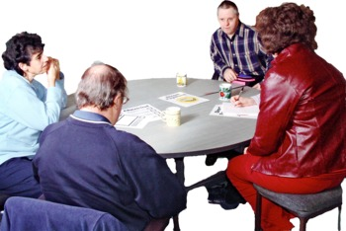

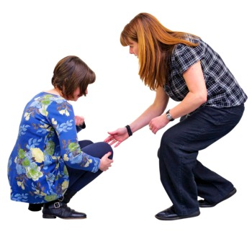
After Visit Process 1
Meet as a team to talk about the visit
Get more information from the provider if needed
Support from other organisations if needed

Slide 57



After Visit Process 2
Draft report written
Draft report checked
Draft report sent to provider for their comments within 30 days
DRAFT
✓

Slide 58
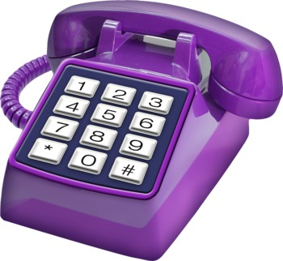

After Visit Process 3
Follow up with provider if no comments within 20-30 days
Report changed to include providers comments and recommendations they have agreed to
Final report shared with provider within 10 working days of receiving their comments

Slide 59


After Visit Process 4
Final report shared with everybody involved
Report published on our website
Visit closed
VISIT CLOSED

Slide 60
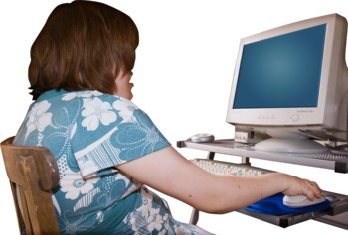
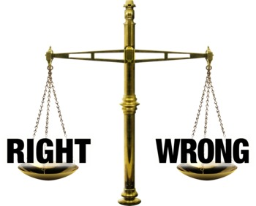

After Visit Process 5
Visit details logged with local Healthwatch and sent to Healthwatch England
Visit reviewed & evaluated
Follow up with provider if needed

Slide 61

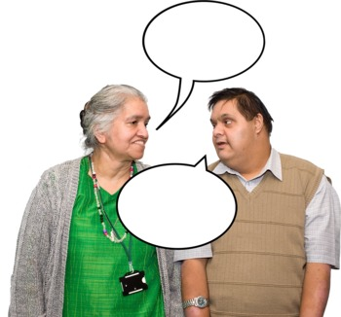
Further Healthwatch Activity
Healthwatch decides how to use information gained from a visit
Findings could be:
Reported to a statutory body such as the Care Quality Commission, the local Health Scrutiny Committee or Health & Wellbeing Board.
Discussed at a steering/task group meeting.
Publicised through a press release.
Talked about with local groups or at a public meeting.
Used to decide what future work is needed.
Used to answer future consultations.
This might mean another visit is needed.

Slide 62
Recap: What have we learnt?
Enter & View is not an inspection
Visits can only be completed by Authorised Representatives
There are times and places when Enter & View is not appropriate
There should be a clear reason for a visit

Slide 63



Recap: What have we learnt?
Discussed how to gather information
Understood how important observations are
Understood when to use open or closed questions
Discussed dealing with conflict

Slide 64



Recap: What have we learnt?
You must follow a process after a visit
The report needs to have a wide range of accurate information including good and bad points
Authorised Representative must not give their own opinions without evidence
There are many things that can happen after a visit

Slide 65
Congratulations!
Next Steps:
Please complete the evaluation form to tell us what you thought of the training. We will email it to you shortly with a copy of your certificate.
Sign off – Healthwatch will need to sign you off as an Authorised Representative
ID Badges – we will need a photograph for your badge
DBS check to be completed
First visit!

