Slide 1
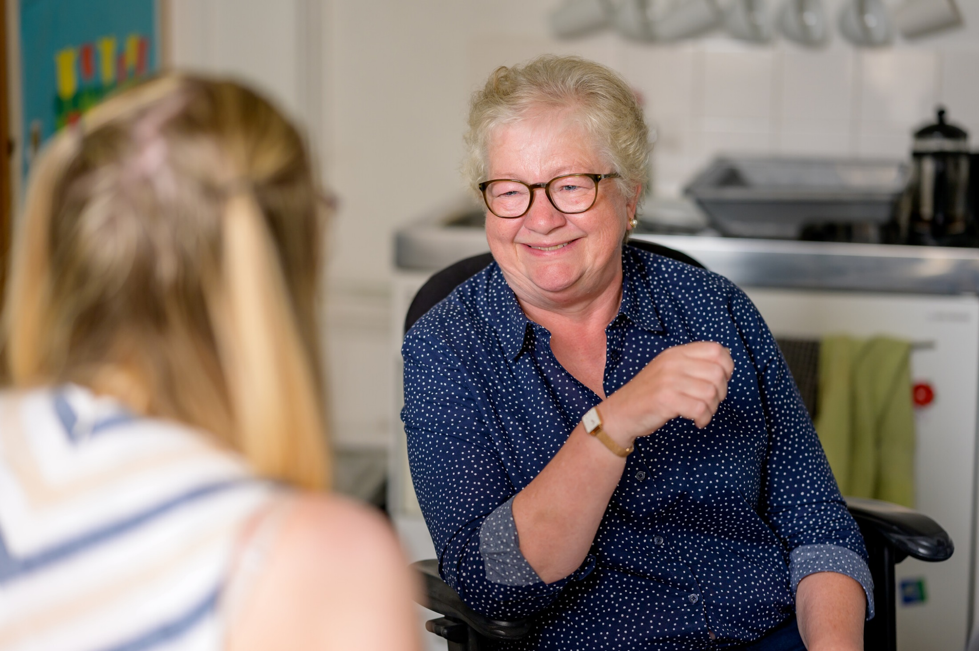
Image: Centre for Ageing Better
Enter and View Training
Residential and Nursing Care Home

Slide 2
Housekeeping Ground Rules
Fire exits and alarms
Toilets
Lunch and breaks
Value everyone’s opinion
One person at a time
Say if you don’t understand
Agree to disagree
No jargon!
Keep to time
Make your point as short as you can
We want to hear from everyone!
Phones on silent

Slide 3
Information about this session
Who is this session for?
This session has been developed for people who have an understanding of Enter and View, and who will be visiting residential and nursing care homes.
By the end of this training, you will:
Understand your role as an Authorised Representative (AR) within the visit
Have gained ideas about how to prepare for and carry out a visit to a care home
Have thought through a range of situations that might come up
Understand what information is required for reporting

Slide 4
Part 1

Slide 5
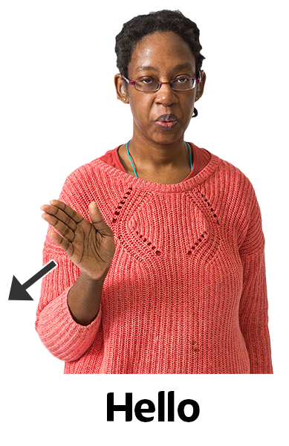
Introductions
Please introduce yourself
How many Enter and View visits to residential or nursing care homes have you been on? 1) none yet 2) a few 3) quite a lot 4) lots!

Slide 6
Types of care home
Care homes provide accommodation for residents who might need help with personal care such as washing, dressing, taking medication and going to the toilet. They might also organise activities and day trips for residents.
Care homes with nursing (also called nursing homes) offer 24-hour assistance from nurses as well as personal care, these homes often offer palliative/End of Life Care.
Care homes with dementia care are designed specifically to help people with dementia feel comfortable and safe. They often have a qualified nurse with dementia training.
Dual-registered care homes accept residents who need both personal care and nursing care. So, if someone moves in only needing help with personal care but they later need nursing care, they wouldn’t have to move to a different home.
Specialist homes for drug/alcohol rehabilitation, Neurological Care, or learning disability homes. These could be long or short-term stay.

Slide 7
What’s the purpose?
Each Enter and View visit must have a stated purpose. For example:
The purpose of this visit is to explore residents, their family and friends, experience of communication with their care providers. Or
The purpose of this Enter and View programme is to engage with residents, their relatives, or carers, to explore their overall experience of living in this care home and their experiences in relation to social isolation and physical activity.
Why is it important to have a stated purpose? What does this achieve?

Slide 8
What’s the purpose?
A clear purpose for a visit leads to clear decisions about who should visit, when, and how the visit will be conducted.
Providers may be more accepting of a visit if they understand why it’s being done.
Residents and family members or friends may be happier to speak to you if they know why you are asking them questions, and what is going to happen with the information they give you.
A clear purpose helps you collect information that will be useful.
A stated purpose needs to be able to stand up to scrutiny and show there was a clear reason for carrying out an Enter and View visit.

Slide 9
What happens during the visit?
You will need to bring:
Conversation prompts/ Questionnaires and clipboard; Pen/pencil
ID badge
Arrival letter.
If you are not well on the day of the visit, please let your Visit Lead know. Even if you feel well enough, you might be visiting people with weakened immune systems.
Some services may have a dress code such as no ties or excessive jewellery.

Slide 10
What happens during the visit?
On arrival:
The lead should introduce themselves and any other ARs to the person in charge of the premises and provide the arrival letter.
All ARs should show their ID and any other documents that have been agreed.
The lead should also agree with the person in charge of the premises who can be approached to talk to and anything else to be aware of on the day, as well as what will happen next.
Remember that speaking to staff is secondary to speaking to residents and their family and friends. Staff may help with communication but should not be providing the ‘answers’.

Slide 11
What is your role?
The Lead Authorised Representative will:
The Authorised Representative team will:

Slide 12
What is your role?
The Lead Authorised Representative will:
Present the Arrival Letter to the manager or senior staff member
Lead the introductions and explain the purpose
Be the point of contact or escalation for the AR team
Spend time with care home staff so that residents have the freedom to have open conversations with the other Healthwatch team members.
Lead the debrief with the senior staff member at the end of the visit
Collect notes or questionnaires from the AR team at the end of the visit
The Authorised Representative team will:
Engage with residents
Take detailed notes of what they hear and what they observe
Escalate any concerns to the Lead AR

Slide 13
Anything not clear so far?

Slide 14
Break!

Slide 15
DoLs: Deprivation of Liberty Safeguards

Slide 16
Deprivation of Liberty (DoLs)
Arrangements for people who lack mental capacity to decide or consent to the arrangements for their care and treatment and who may:
not be allowed to leave the care home or hospital
have very limited, choice about their life within the care home or hospital
be prevented from maintaining contact with the world outside.
There is no definition of what is a deprivation of liberty, it will always depend on the individual situation.
Aim to ensure a person is only deprived of their liberty where this is necessary for their safety, and that they receive the care and treatment they need. People have access to a court to challenge their detention and a representative to support them.
If someone is at risk of, or is already being deprived of their liberty, the managing authority of the care home or hospital must apply for authorisation to the Local Authority (called supervisory body), and their policies and processes must be followed.

Slide 17
What do we do about this?
Deprivation of Liberty Safeguards (DoLs)
The AR team are not expected to be experts in DoLs.
Ask the senior staff member during the introduction conversation whether there are any DoLs in place
If potential DoLs are observed, ARs should make an accurate note of what was observed or disclosed and advise the Lead AR before the end of visit debrief with the Home senior staff
Any further action will be decided and/ or taken by the Local Healthwatch Safeguarding Lead
For more information: https://www.scie.org.uk/mca/dols/at-a-glance/

Slide 18
Safeguarding
Safeguarding is for people who, because of issues such as dementia, learning disability, mental ill-health or substance abuse, have care and support needs that may make them more vulnerable to abuse or neglect.
What things might you see in a care home which could make you wonder if you should report a concern about how someone is being cared for or looked after?

Slide 19
Types of organisational or institutional abuse
Discouraging visits or the involvement of relatives or friends
Poor quality care which is a direct result of insufficient staff or high turnover
Abusive and disrespectful attitudes towards people using the service
Lack of respect for dignity and privacy
Failure to manage residents with abusive behaviour
Not providing adequate food and drink, or assistance with eating
Not offering choice or not promoting independence
Misuse of medication
Failure to provide care with dentures, spectacles or hearing aids
Not taking account of individuals’ cultural, religious or ethnic needs
Interference with personal correspondence or communication
Failure to respond to complaints

Slide 20
What do we do about this?
Follow your safeguarding policy!
If you witness abuse, or if the person is in immediate danger:
call 999
find the Lead AR who will advise the senior staff member of the incident and end the visit immediately
The Lead AR and the visiting team will contact their Healthwatch Safeguarding lead and/ or management team who will manage the escalation and next steps
If abuse has been disclosed but not witnessed by you:
Let the person know that what they have said concerns you and that you would like their permission to share the information with the Lead AR which may lead to a safeguarding concern being raised.
Discuss with the Lead AR who will follow the Healthwatch Safeguarding policy and escalate and report as directed.

Slide 21
Dementia
Bookcase Analogy

Slide 22
Dementia
Dementia affects everyone differently so it's important to communicate in a way that is right for the person. Listen carefully and think about what you're going to say and how you'll say it. You can also communicate meaningfully without using spoken words.
Observation of non-verbal cues are important, even if you don’t get to have a full conversation to gather the experience.
Is the resident calm, content, and happy?
Are they dressed appropriately for where they are? The season?
Is their hair done?
Do staff acknowledge them?
How do they react to each staff member?
Are they assisted to move, eat or reminded to drink if necessary?

Slide 23
Dementia
Make sure the person you are talking to is comfortable, not hungry, thirsty, or in discomfort before you start.
Use short simple sentences, but don’t talk down to them – they are adults.
Be conversational rather than questioning. If you have to ask questions, try to use closed questions as yes/no answers are easier to process than having too many choices.
Allow time between sentences for the person to process the information and respond.
Try to let the person complete their own sentences - try not to be too quick to assume you know what they are trying to say.
Try to laugh together about any misunderstandings and mistakes. Humour can help to relieve tension but make sure the person doesn’t feel you are laughing at them.

Slide 24
Break!

Slide 25
Part 2

Slide 26
Inclusion, Equality, Allyship

Slide 27
How could difference affect residents?
Examples of how one resident’s experience might be different to the experience of others because of their personal characteristics:

Slide 28
How could difference affect residents?
Examples of how one resident’s experience might be different to the experience of others because of their personal characteristics:
Care staff and Nursing staff not knowing how to provide personal care to someone who has transitioned.
Care staff coming from countries or cultures where being gay is illegal – or ‘against God’ and not being able to separate this from their care responsibilities.
Cultural differences: food or behaviour that aren’t found in the care home.
Gay men with Dementia – they may have come out after ‘Section 28’ had ended, but their memories may have them back in the time where being Gay was illegal – they may be fearful that people will ‘find out’, or they may feel that they have to ‘come out’ all over again.
Trans people may have different personal care needs. May experience staff lifting sheets to ‘have a look’ (true story from a trans resident).

Slide 29
Is inequality equal?

Slide 30
Are ‘microaggressions’ really that tiny?

Slide 31
What’s the risk if we’re not aware of bias and microaggressions?
We could:
Interpret what they say or do with preconceived ideas about them.
Blame them for not doing something or acting in a certain way.
Make them feel like an outsider – alienating them.
Make them feel isolated and with no-one who understands them.
Dismiss their concerns as being because they are too sensitive, elderly or confused.
Contribute to them not having the same opportunities or care.
Disrespect them – showing low regard or esteem for them. All leading to them feeling like they don’t belong and no-one wants them here.

Slide 32
What can I do?
Names are important
Ask someone how they pronounce their name – and practice! Get it right, don’t say ‘oh – I’ll call you x’
Pronouns are important
Being misgendered negatively impacts people’s mental health. Follow their lead, ask someone (privately) how they prefer to be addressed. Try not to make assumptions.
Where are you from? – accept the answer, don’t add the ‘where are you really/ originally from?’
Remember there is a difference between nationality and ethnicity.
If you get it wrong – and we all will sometime – apologise, don’t get defensive. ‘I’m sorry, I meant [correct name/ pronoun/ title]’ – keep it brief, the apology isn’t all about you or the mistake.

Slide 33
The visit

Slide 34
Prior to visit
The visiting team should have been briefed on:
Is this visit Announced or Unannounced
The stated purpose – what type of conversations are you expected to have?
Type of care home being visited and any recommendations that may have been made previously if this is a repeat visit
Which ARs are involved and who is taking the role of Lead
Ensure everyone on the visiting team knows what you’ll do should you find when you arrive that a resident has just passed away, or if there is a severe medical situation with a resident while you are there.

Slide 35
You’re in the door! Now what?
Be professional and friendly!
Take note of what is going on around you – the sounds, smells, and sights are all important.
Who are you going to have a conversation with? Find your person.
Introduce yourself, explain who you are – and what Healthwatch does – and why you would like to have a chat with them.
Seek consent – “are you happy to have a chat?”
Offer the option not to participate if they don’t wish to.
Explain what will happen with any information they share with Healthwatch, how it will be used and stored, including how any notes taken will comply with your data protection policy. Have the policy with you for people to see if they want to.
How to get in contact with Healthwatch after the visit.
Take notes. Offer to show people what you are writing – it’s their story after all.

Slide 36
Where to talk?
Lounge?
Bedroom?
Dining room?
Garden?
With Groups of residents? Or Individuals?
Anywhere that residents, or their families and carers are happy to chat.
You will find a lot of residents are bedbound or prefer to stay in their rooms. Your Healthwatch may have a view on this.
BUT!
Safety first!

Slide 37
Bedrooms
With increasing numbers of Care Home residents being bedbound, it is important that we consider how we might hear about their experience of care.
With bedrooms NOT being part of the communal area – how do we speak to these residents?
What topics of conversation would be helpful to hear about things from their perspective?

Slide 38
Conversations and Questions
How do I start?
Introduce yourself, your Healthwatch, and your role – as an example:
“Hi there, My name is ____, I work/ I’m a volunteer with Healthwatch ____.Healthwatch is an organisation set up to make sure people have their voices heard by people who provide or pay for health and care services such as *this care home* We are here today to ask how people living here feel about * purpose of visit *. Is it ok for me to sit and have a chat with you?”
If people prefer not to talk to you – thank them and move on.
If they consent – thank them, and then explain that you are going to be making notes while you speak, that any information will be anonymous, how it will be used, and why.
People can change their minds and withdraw consent at any stage.
Remember that at its heart, Enter and View is just a bunch of people talking (listening) to a bunch of people.

Slide 39
Practical tips and tricks
Starting and guiding conversations
Your conversations will be based around the information you need to support the purpose for your visit.
Make sure you are familiar with the questions you are looking to answer and use these as conversation prompts. Alongside the general Conversation Prompt document.
If the conversation falters, or goes too far off track, bring it back with one of the questions that haven’t been answered through the conversation so far.
If you are getting non-committal or one-word answers, follow up with a why/ how/ who or when type question to draw out the reason for the answer.
Observe the person – body language and non-verbal cues are important

Slide 40
Break!

Slide 41
Scenario section of Part 2

Slide 42
Scenario discussion 1
Your first conversation on a visit to Garfield Nursing Home is with Lucy who had just been playing a card game with one of the care assistants. You sit next to them in the busy day room and Lucy very quickly starts telling you lots about different members of their family.
You try to ask Lucy some of your favourite introductory questions about day-to-day life at the nursing home, but after a one or two word answer they go back to telling you stories about the lives of their family members.
The care assistant interrupts them every so often to try and help answer your questions, but they are giving you their own answers from their point of view.
What issues does this raise?
What things would you think about as an Authorised Representative?
What might you do?

Slide 43
Scenario discussion 2
You’ve completed a few useful conversations with residents at Banford House, which is a dual-registered care home. You’re getting an overall impression that they see the long-serving owners and small staff team as caring, but also quite traditional or maybe even old-fashioned. You’re surprised at how many residents previously lived a long distance away from the small town where the home is located.
The home manager tells you that Malcolm, a man in his early 80’s had been saying all week that he wanted to speak with Healthwatch when you visited. You find him sitting reading a newspaper in a side-alcove of the day room. However, he now seems very uncertain about talking with you. He’s only really giving you ‘yes’ or ‘no’ answers to your questions and seems to have other things on his mind. What issues does this raise?
What things would you think about as an Authorised Representative?
What might you do?

Slide 44
Scenario discussion 3
Sedgington Manor is a large care home with dementia care. It recently changed ownership as it was bought by a large national provider. You’re aware that the new manager who was transferred from another home owned by the same company has only been here a couple of months.
It takes ages to be let in when you first arrive. The manager very quickly starts rushing you around on a tour of the extensive building. Other staff you pass as you walk with the manager seem distant and avoid engaging with the manager, but they are all in a rush to go somewhere.
All residents are in their bedrooms – you can hear lots of TVs – apart from one man who’s asleep in a chair in the day room. You’re told a poster about your visit has been displayed for weeks, but you’re aware there have been no responses to the survey for family members that it mentions. What issues does this raise?
What things would you think about as an Authorised Representative?
What might you do?

Slide 45
Scenario discussion 4
You’ve been getting a fairly good impression of the newly refurbished Anglia Heights specialist neurological care home. As you were shown around by the manager and a regional manager, who happens to be here today, you could see many residents occupied with activities led by staff. There are good modern facilities, and signage and notice boards are cheery; though maybe a bit ‘corporate’ feeling for your liking.
As you’re heading to the dining room for the start of the lunch service, a family member of a resident pulls you aside. They say to you, “you realise they’re just putting on a good show for you today, don’t you? I’m not saying there’s anything terrible about the place, but I’ve never seen so many staff on shift, and usually people are just left to sit about and almost ignored. We’re looking for somewhere else more homely for our son.”
The family member doesn’t seem keen to say more and rushes off. What issues does this raise?
What things would you think about as an Authorised Representative?
What might you do?

Slide 46
Scenario discussion 5
Hassan is a first-language British Sign Language (BSL) user who is talking to you with support from the Personal Assistant (PA) that he employs to take him out to socialise. They interpret for him when they are with him three times each week. They also end up having to do this as a favour for Hassan when the GP visits him, because the care home and GP surgery are in dispute about which of them should cover the cost of interpreting.
Over the last two years, his sight has hugely deteriorated, and he can’t now read many things. However, he tells you the home manager won’t accept that he needs any help with this.
He tells you that at the moment he’s self-funding, so pays the home £1,800 per week. However, his savings are running low, and he’ll soon be funded by the Council, who will pay the home their usual fee of £1,000. He tells you that the home are trying to delay this drop in their income by pressuring his PA to reduce how much he spends going out for meals and on trips. What issues does this raise?
What things would you think about as an Authorised Representative?
What might you do?

Slide 47
After the visit section of Part 2

Slide 48
What happens after the visit?
Volunteer Debrief – reflection and a chance to talk about conversations that might have been upsetting.
Getting your notes to the Lead AR who will pass them to the person writing the report
Report written and submitted to provider within 20 working days.
Findings are also shared with regulators, local authority, NHS commissioners and quality assurers, the public, Healthwatch England and any other relevant partners.
Service providers must respond to our report and its recommendations within 20 working days.
Disseminate and publish the report
**Follow-up within 12 months to see our impact**

Slide 49
Did we achieve the aims of the training?
By the end of this training, you will:
Understand your role as an Authorised Representative (AR) within the visit
Have gained ideas about how to prepare for and carry out a visit to a care home
Have thought through a range of situations that might come up
Understand what information is required for reporting

Slide 50
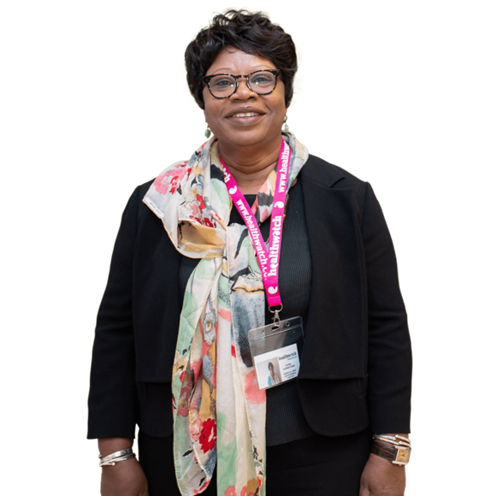
Congratulations!
You have now completed our Enter & View training for visits to residential and nursing care homes!
Thank you for offering your skills and time to help improve services for residents in these homes.
We look forward to working with you.

